Slide 1
Progression in Mastery
Year 5 Adverbial Phrases and Fronted Adverbials
Are you ready to recap adverbials?
©Deepening Understanding LTD 2020

Slide 2
Let’s do this!
What is the same and what is different?
adverbial phrase
fronted adverbial
©Deepening Understanding LTD 2020

Slide 3
Let’s revisit what we should know…
An adverbial is a word or phrase that is used like an adverb to describe or change a verb.
1. The villagers were forced to evacuate their homes before the storm.
2. Asha placed the ornament on the window ledge.
3. The aeroplane soared through the clouds.
©Deepening Understanding LTD 2020

Slide 4
Let’s revisit what we should know…
An adverbial becomes a fronted adverbial when
it is positioned at the beginning of a sentence.
We use a _______ after a fronted adverbial.
1. While the sun set, we finished our picnic.
2. All of a sudden, the door violently swung open.
3. Eventually, they made their way back to the castle.
©Deepening Understanding LTD 2020

Slide 5
Let’s talk
Identify the adverbial phrase in each sentence.
Which sentences use a fronted adverbial?
1. Caleb is waiting for you by the swimming pool.
2. In the forest, there is an abandoned shack.
3. Behind the museum, there are beautiful gardens.
4. The whole community gathered together in the town hall.
©Deepening Understanding LTD 2020

Slide 6
Let’s talk
Use each of the adverbial phrases in a sentence.
as quick as a flash
in the distance
down by the river
barely alive
©Deepening Understanding LTD 2020

Slide 7
Let’s talk
Add fronted adverbials to the sentences.
1. The man grows lots of vegetables.
2. They heard a huge explosion.
3. The children set up their new tent.
4. We went to our favourite restaurant for dinner.
©Deepening Understanding LTD 2020

Slide 8
Let’s develop our learning
Anita says she has used one adverbial phrase in her sentence.
Do you agree with her?
Explain your reasoning!
When the doctor arrived, she took Marlon’s temperature before giving him the medicine.
©Deepening Understanding LTD 2020

Slide 9
Let’s develop our learning
Always, Sometimes or Never?
Prove it!
A sentence will still make sense if you make its adverbial phrase a fronted adverbial.
©Deepening Understanding LTD 2020

Slide 10
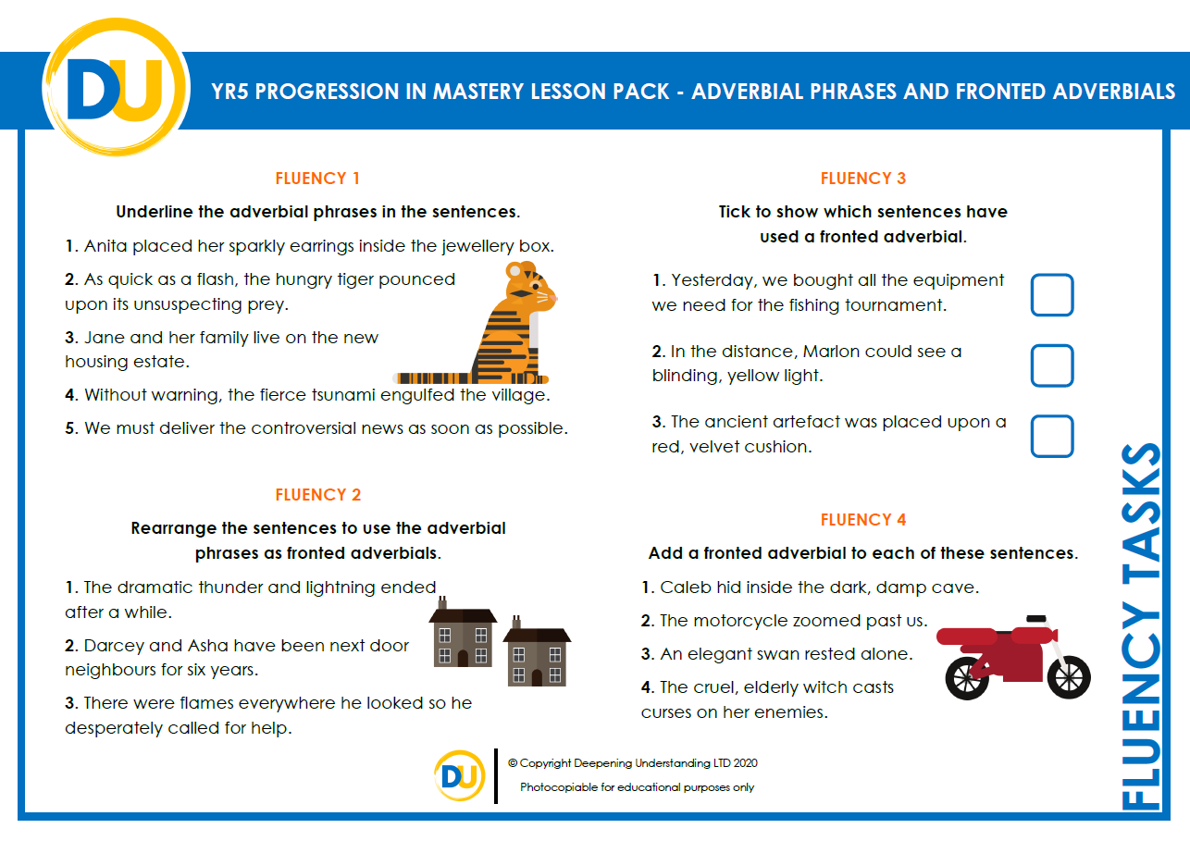
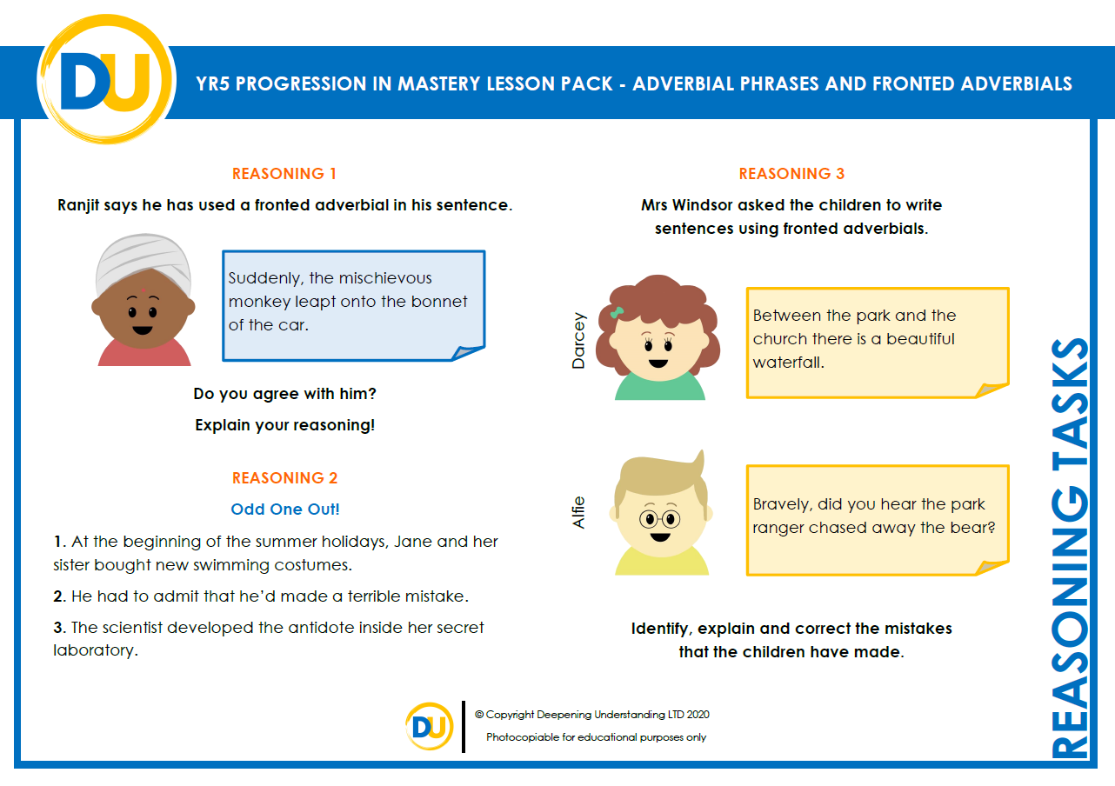
Independent Task
Let’s showcase our learning
©Deepening Understanding LTD 2020

Slide 11
Exit task – Dong Nao Jin
Choose an adverb and use it to create an adverbial phrase.
NOW… Challenge your partner to use your adverbial phrase as a fronted adverbial in a sentence.
on
above
by
after
next to
before
in
over
©Deepening Understanding LTD 2020

