Slide 1
Progression in Mastery
Year 5 Gravity
Let’s find out all about gravity!
©Deepening Understanding LTD 2020

Slide 2
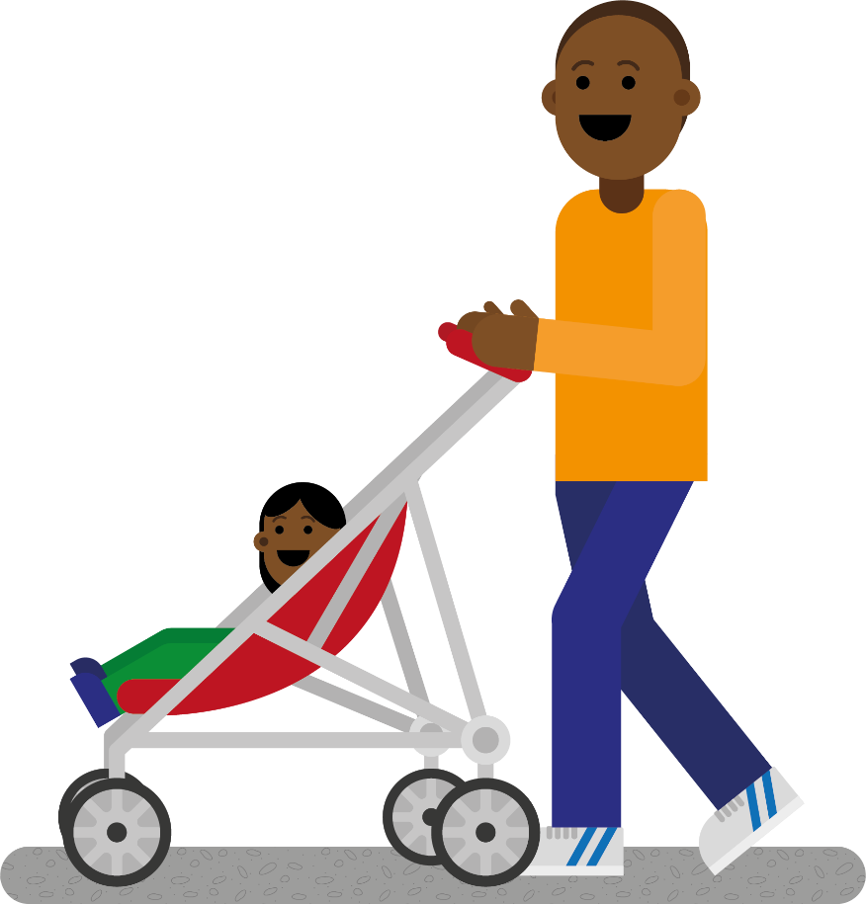
Remember the Science
We often think of forces as pushes or pulls.
How many examples of pushing and pulling forces can you name?
Walking with a pram is an example of a pushing force.
Zipping up a jacket is an example of a pulling force.
©Deepening Understanding LTD 2020

Slide 3
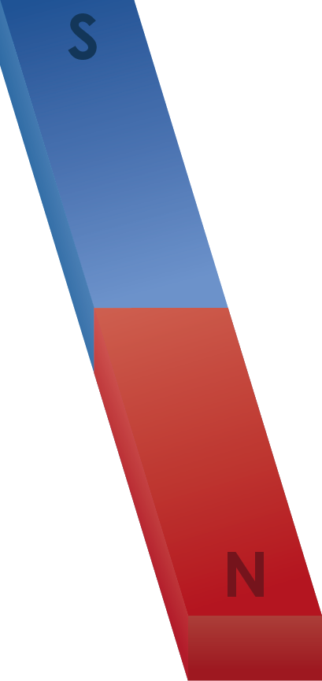
Remember the Science
Magnetic forces can be observed using _________.
Name three materials which are magnetic and three which are not.
Magnets have two poles – the ______ and the ______.
Opposite poles ______ each other but the same poles ______.
©Deepening Understanding LTD 2020

Slide 4
Talk like a Scientist
Gravity is an example of a _________ force.
What can you tell me about gravity?
©Deepening Understanding LTD 2020

Slide 5
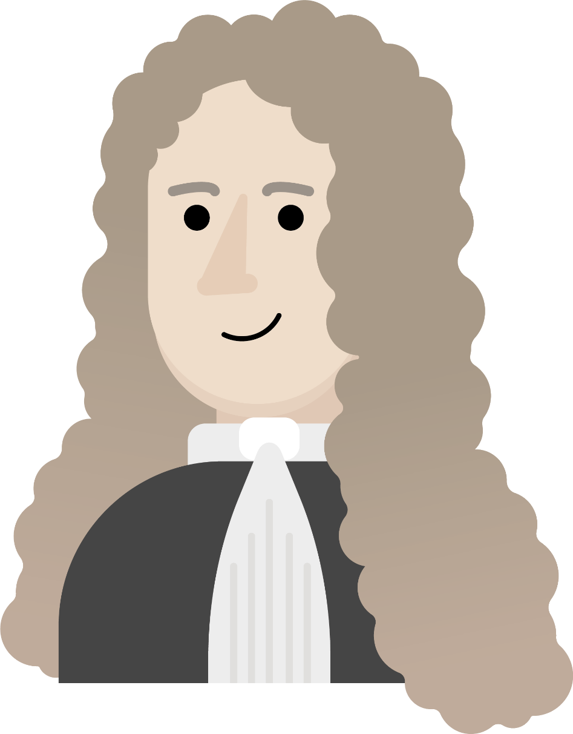
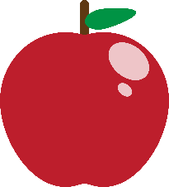
Know the Science
In the late 1600s, Sir Isaac Newton, an English mathematician and scientist, discovered the force of gravity.
It is believed that he saw an apple fall from a tree to the ground, and wondered why objects always fall down to the Earth rather than turning sideways or shooting upwards.
©Deepening Understanding LTD 2020

Slide 6
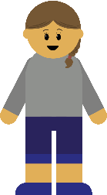
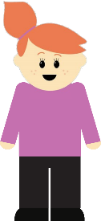
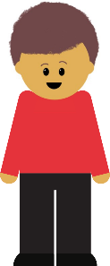
Know the Science
He concluded that gravity is a force which pulls
objects down towards the centre of the Earth.
What would happen if there was no gravity on Earth?
©Deepening Understanding LTD 2020

Slide 7
Know the Science
When an unsupported object falls towards the Earth, the
force of gravity acting between the Earth and the object
causes it to fall down to the ground.
©Deepening Understanding LTD 2020

Slide 8
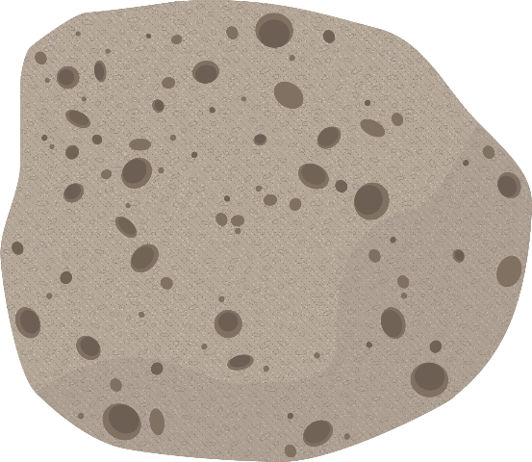
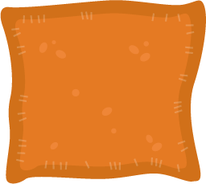
Talk like a Scientist
Do all objects fall at the same speed?
©Deepening Understanding LTD 2020

Slide 9
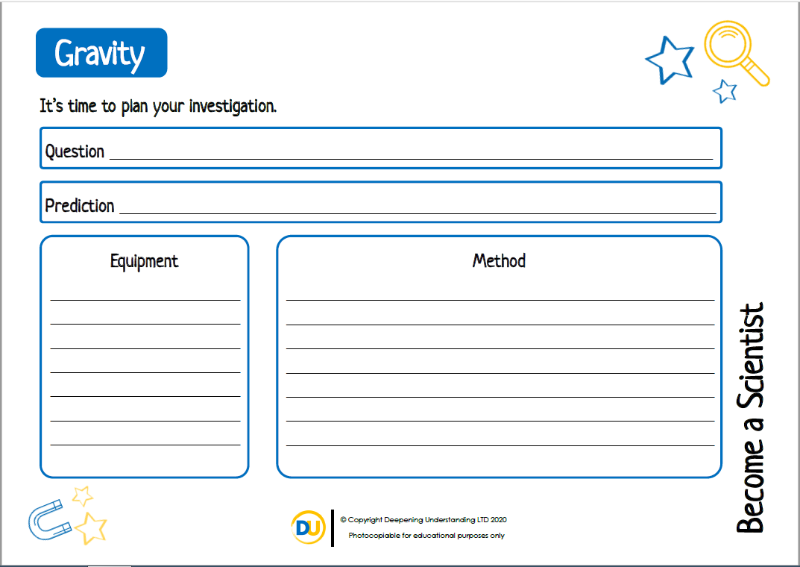
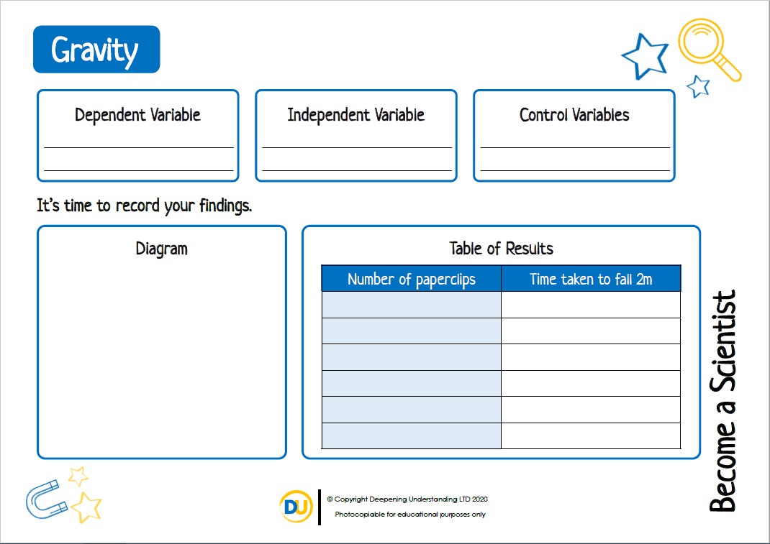
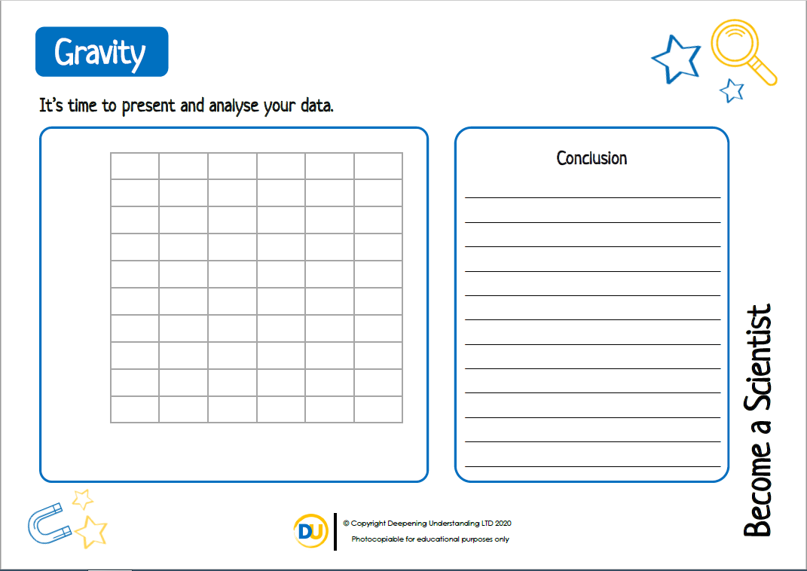
Act like a Scientist
Let’s investigate gravity further to deepen our understanding…
©Deepening Understanding LTD 2020

Slide 10
Independent Task
Become a Scientist
©Deepening Understanding LTD 2020

Slide 11
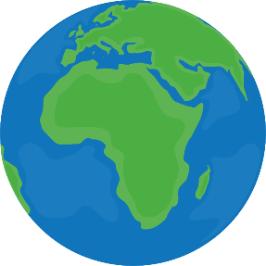
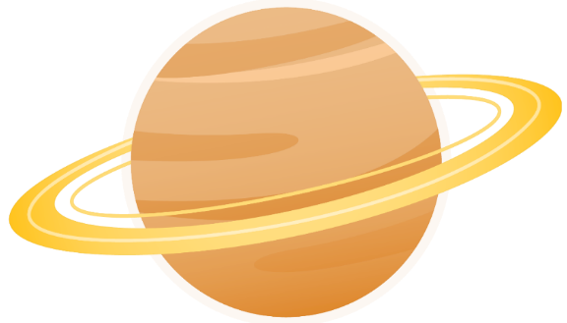
Think like a Scientist
Who do you agree with?
Gravitational force is the same throughout the solar system.
Jane
There is less gravity on smaller planets.
Gravity only exists on Earth.
Marlon
Jerry
©Deepening Understanding LTD 2020

Slide 12
Exit task – Checking the tricky bits
Let’s try answering Ranjit’s question again…
What can you tell me about gravity?
©Deepening Understanding LTD 2020

