Slide 1
Progression in Mastery
Year 5 Air Resistance
Let’s find out all about air resistance!
©Deepening Understanding LTD 2020

Slide 2
Remember the Science
The mass of an object is a measure of the amount of ________ it contains.
©Deepening Understanding LTD 2020

Slide 3
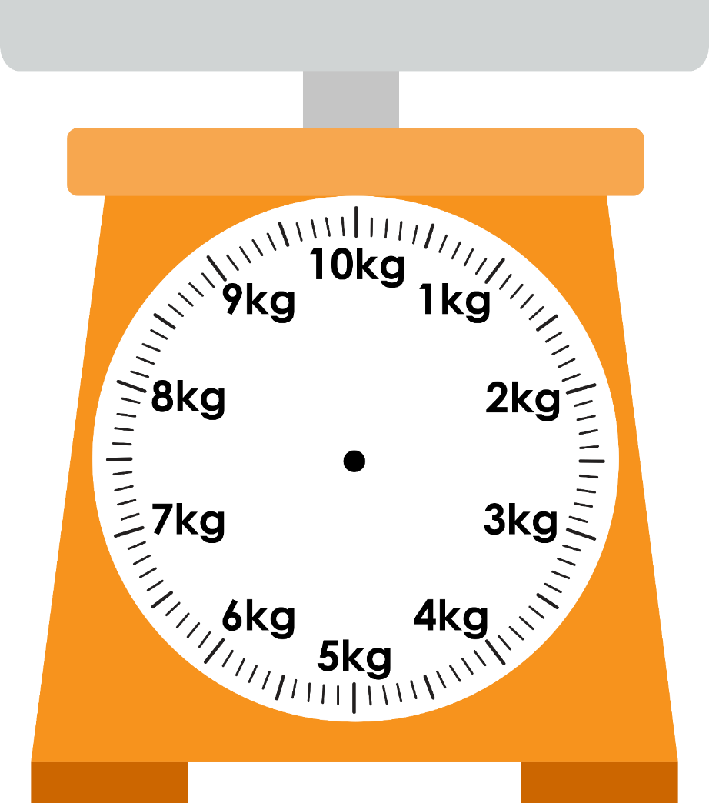
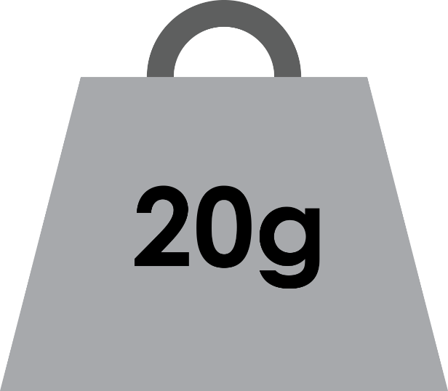
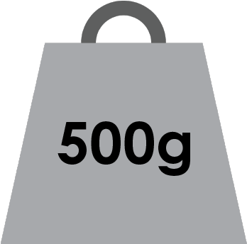
Remember the Science
The weight of an object is a measure of the amount of ________ needed to support its ________.
©Deepening Understanding LTD 2020

Slide 4
Remember the Science
We can measure the force of gravity pulling on objects
using a ________(also known as a ________).
We measure forces in ________.
©Deepening Understanding LTD 2020

Slide 5
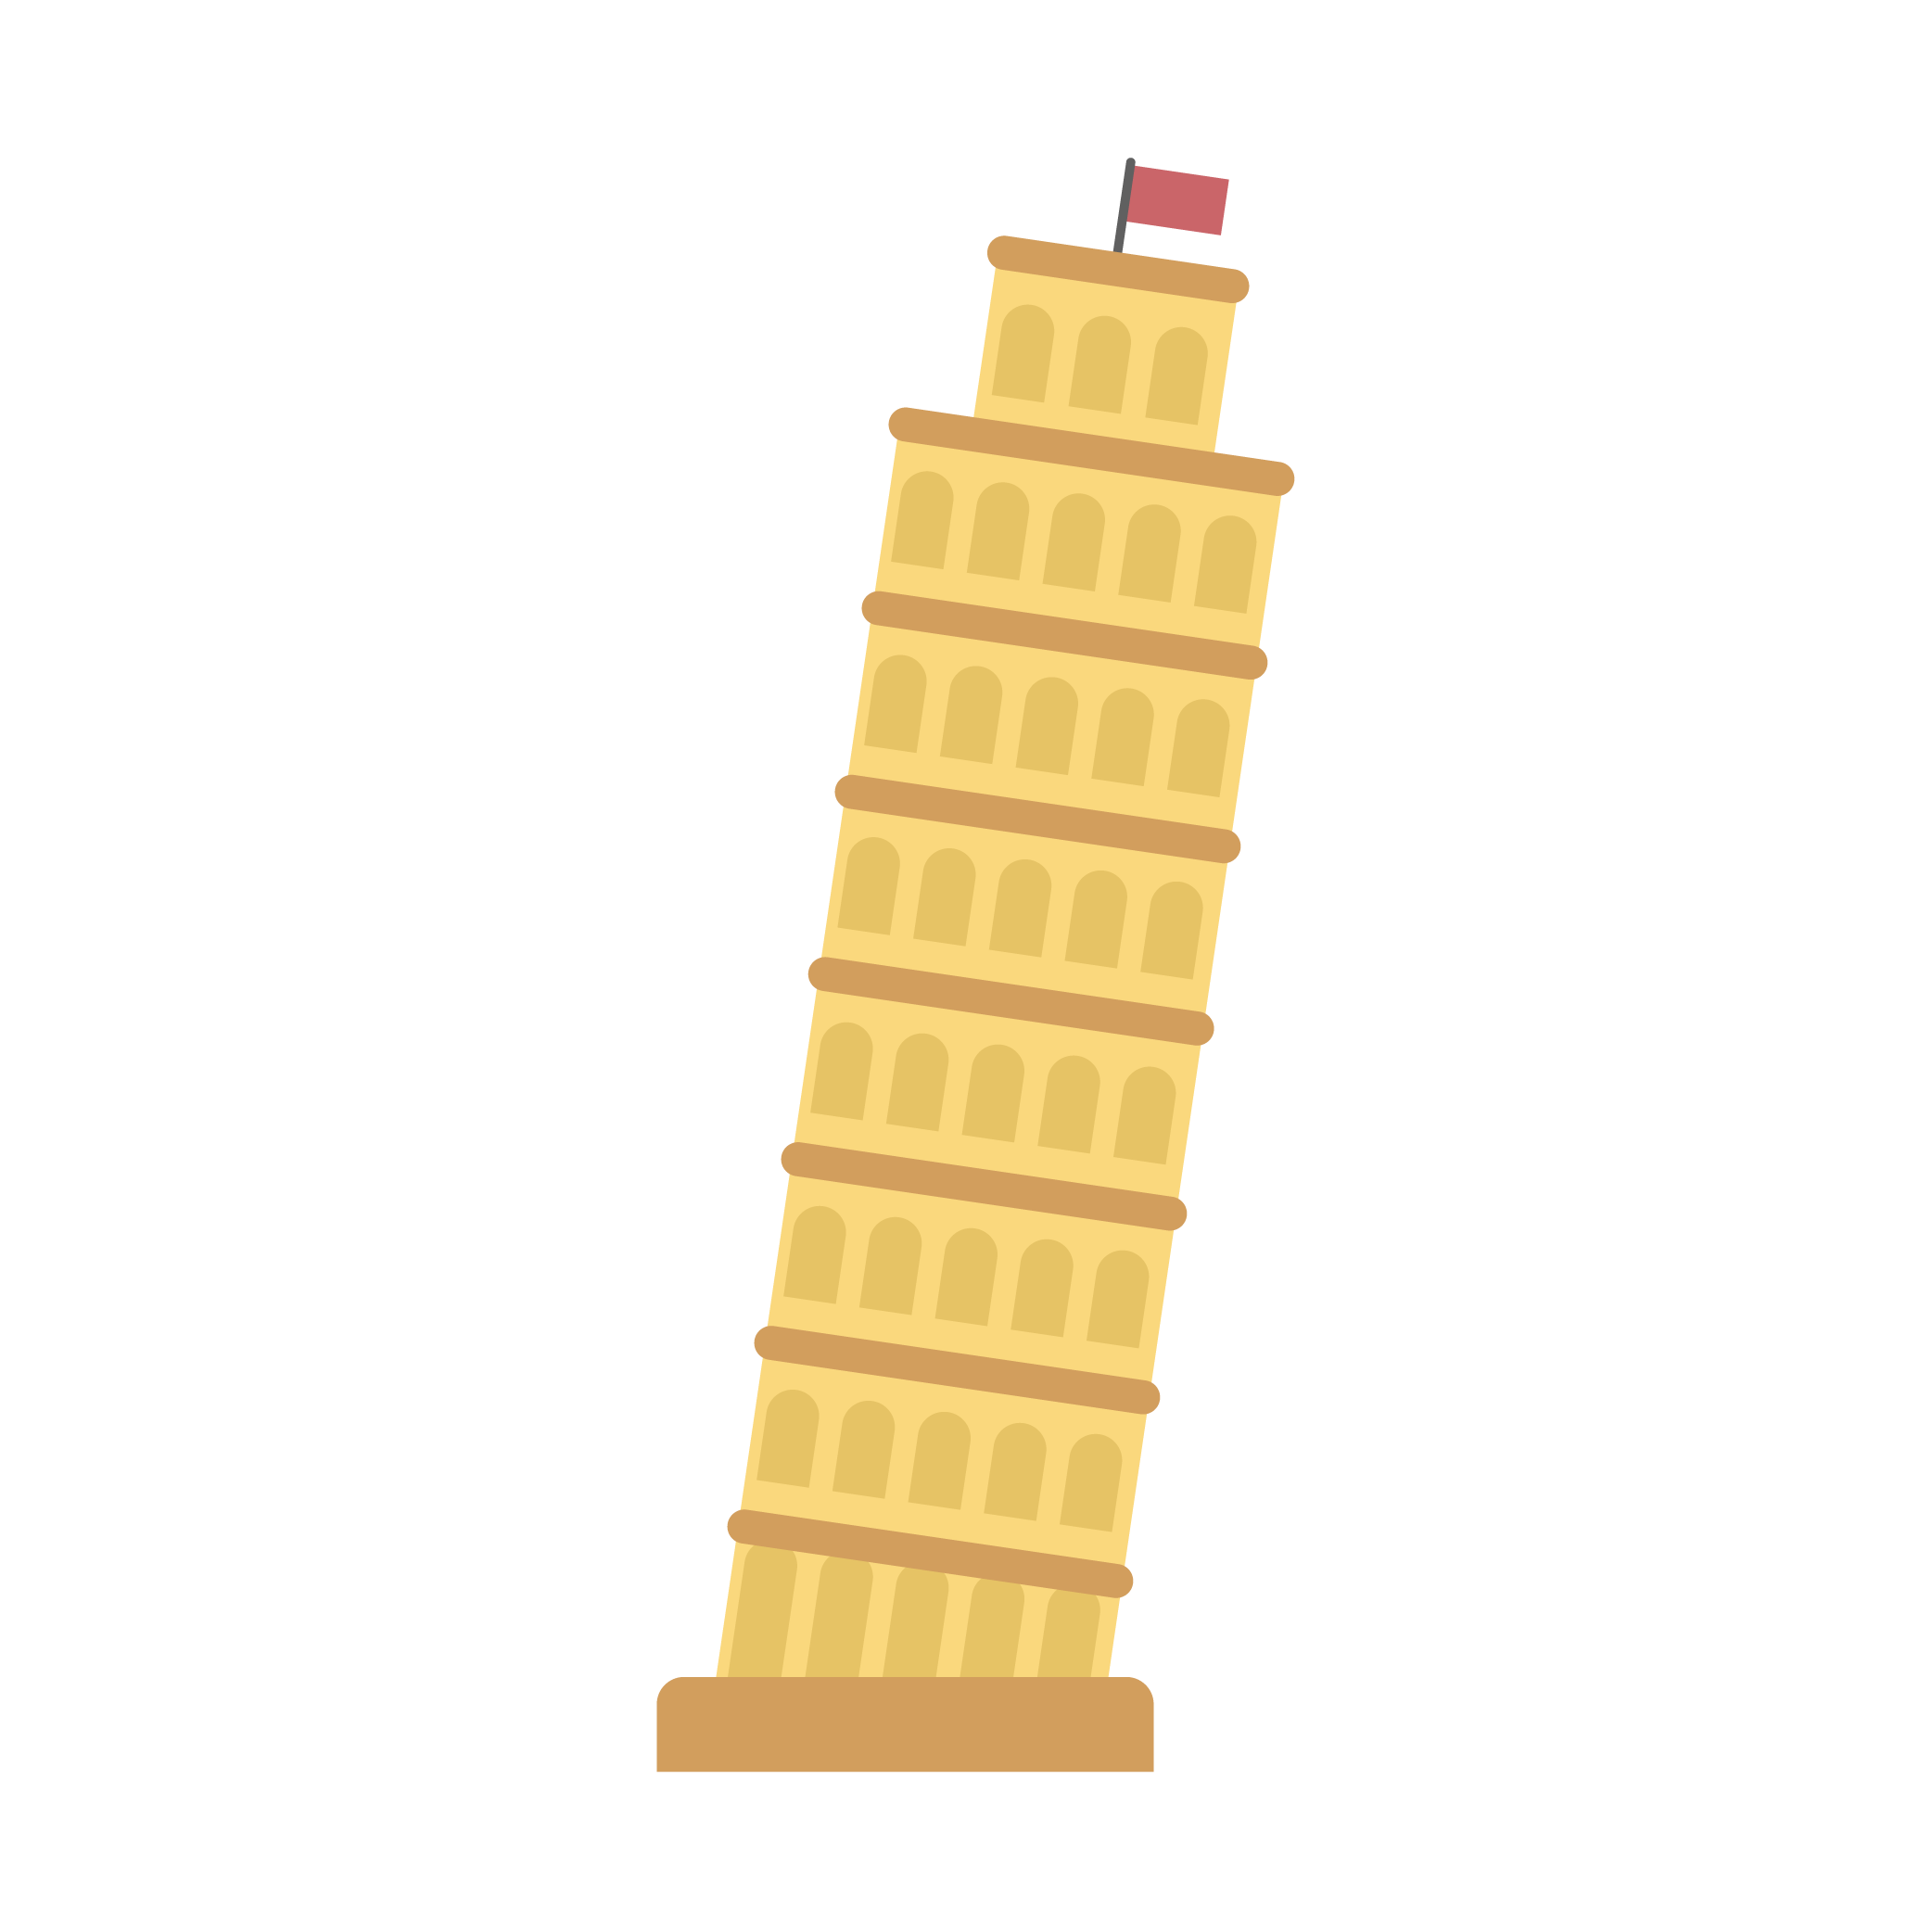
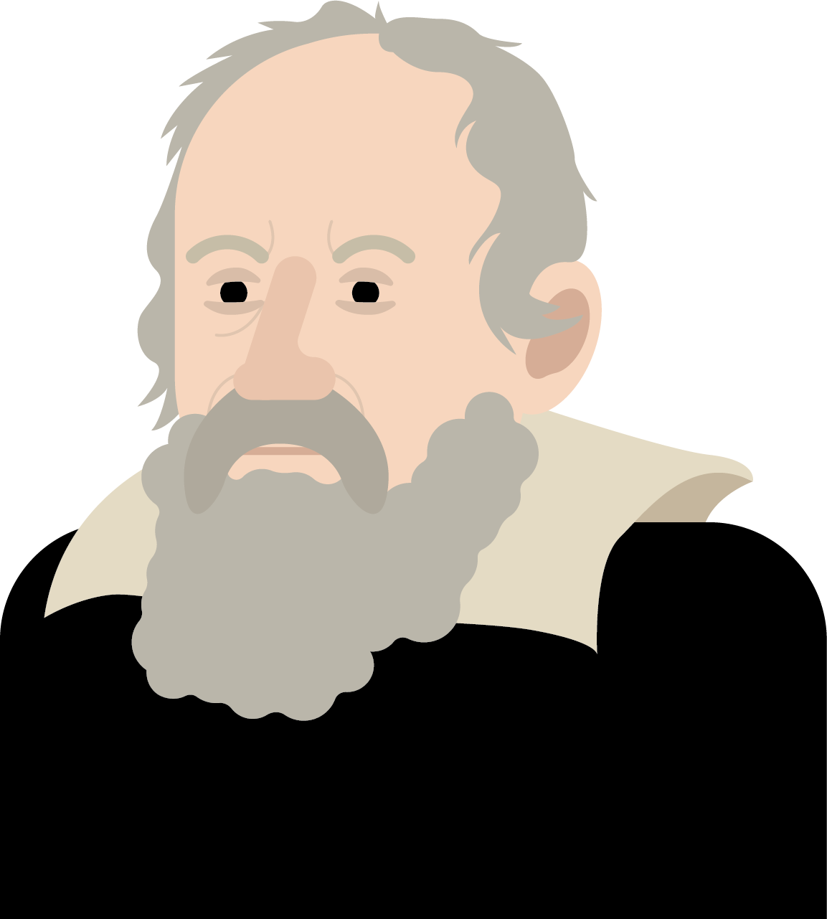
Know the Science
Between 1589 and 1592, an Italian scientist called Galileo Galilei dropped two spheres of different masses from the Leaning Tower of Pisa to see which would hit the ground first.
Which sphere do you think hit the ground first?
©Deepening Understanding LTD 2020

Slide 6
Talk like a Scientist
Despite the difference in mass, both fell at exactly the same rate and hit the ground at almost the same time!
Why do you think this happened?
©Deepening Understanding LTD 2020

Slide 7
Know the Science
Galileo Galilei’s experiment proved that regardless of the mass of an object, the force of gravity affects all objects equally.
Would the results have differed if the objects were shaped differently from one another?
©Deepening Understanding LTD 2020

Slide 8
Think like a Scientist
If a feather and a bowling ball were dropped at the same height at the same time, which one would land on the ground first?
Why do you think this happens?
©Deepening Understanding LTD 2020

Slide 9
Know the Science
The bowling ball would land first because of air resistance. The feather has a wider surface area in comparison to its size.
This means that there will be more friction
acting against it, which will slow it down.
©Deepening Understanding LTD 2020

Slide 10
Know the Science
When an object moves through the air, the force that
acts in the opposite direction is called air resistance.
The faster an object moves through the air,
the less friction there is.
©Deepening Understanding LTD 2020

Slide 11
Know the Science
Air resistance can be seen everywhere.
For example, when driving a car, air resistance pushes in the opposite direction which helps slow the car down.
Where else can you see air resistance?
©Deepening Understanding LTD 2020

Slide 12
Talk like a Scientist
Discuss Jerry’s question with your partner…
What is the same and what is different about gravity and air resistance?
©Deepening Understanding LTD 2020

Slide 13
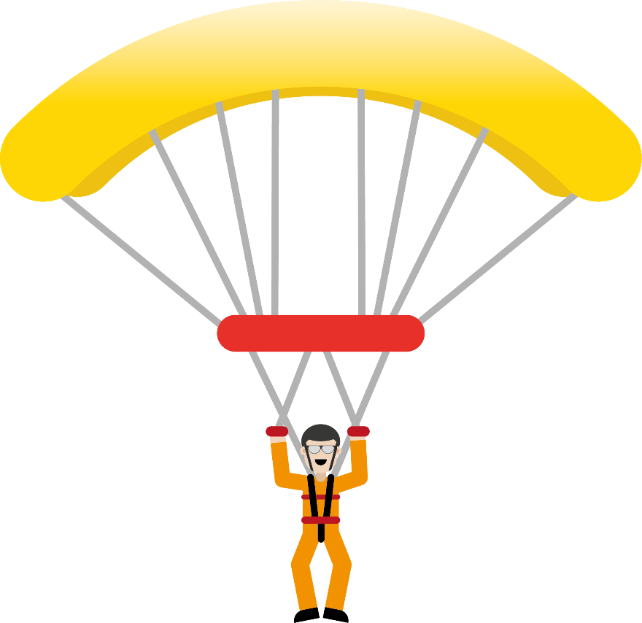
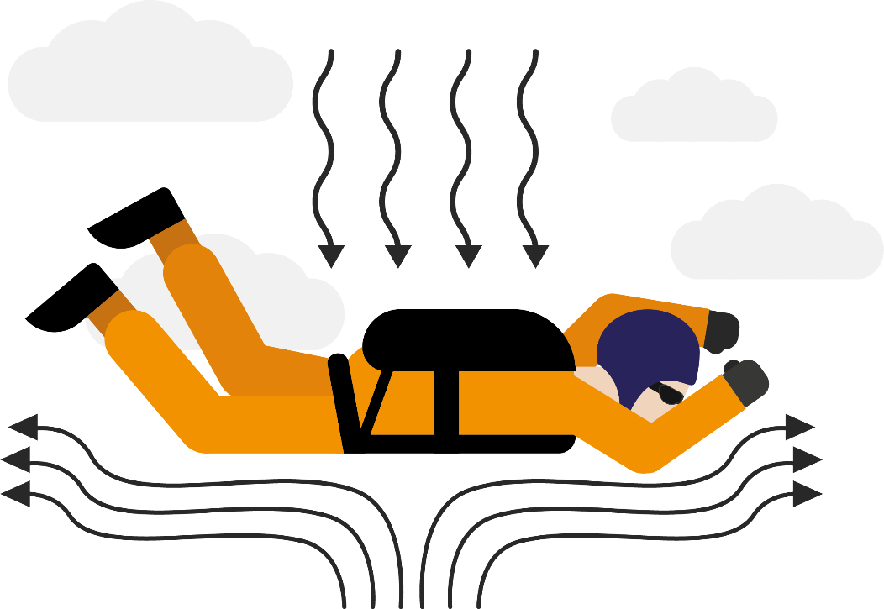
Know the Science
Both gravity and air resistance are fixed forces of nature – they both interact with anything moving through the air.
As seen with the feather, the more surface area an object has, the more air resistance there is to slow it down – that’s why parachutes are so large!
©Deepening Understanding LTD 2020

Slide 14
Act like a Scientist
Let’s explore the relationship between surface area and air resistance…
©Deepening Understanding LTD 2020

Slide 15
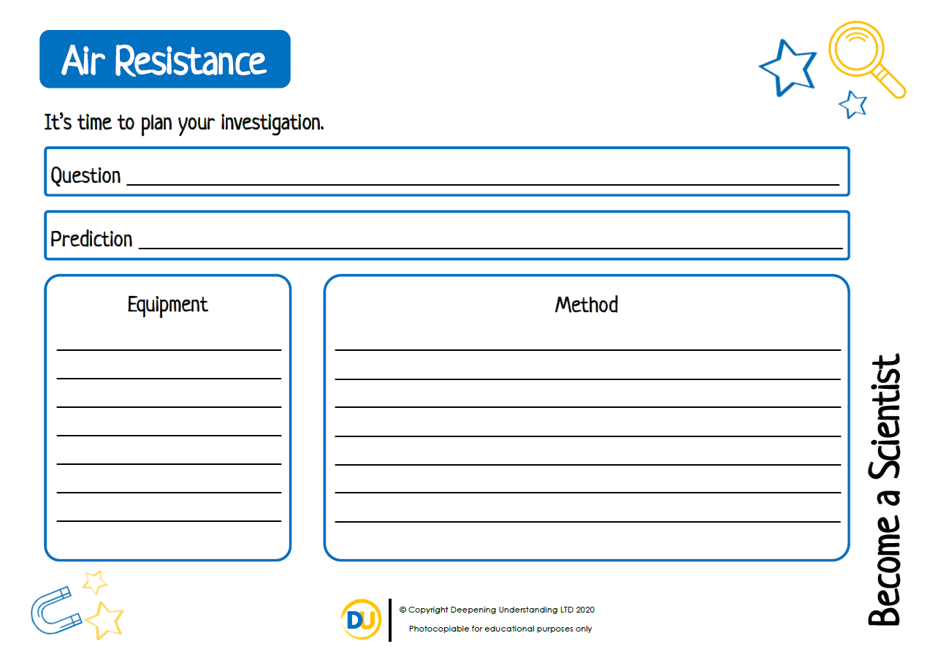
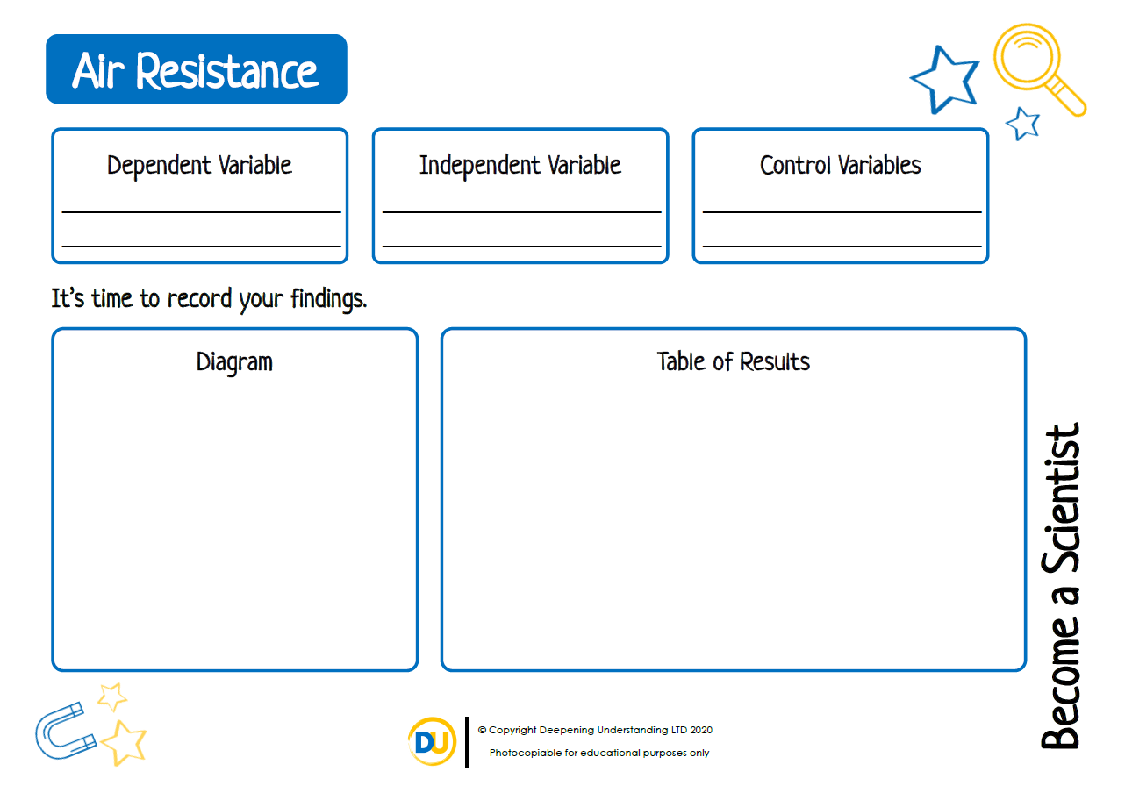
Independent Task
Become a Scientist
©Deepening Understanding LTD 2020

Slide 16
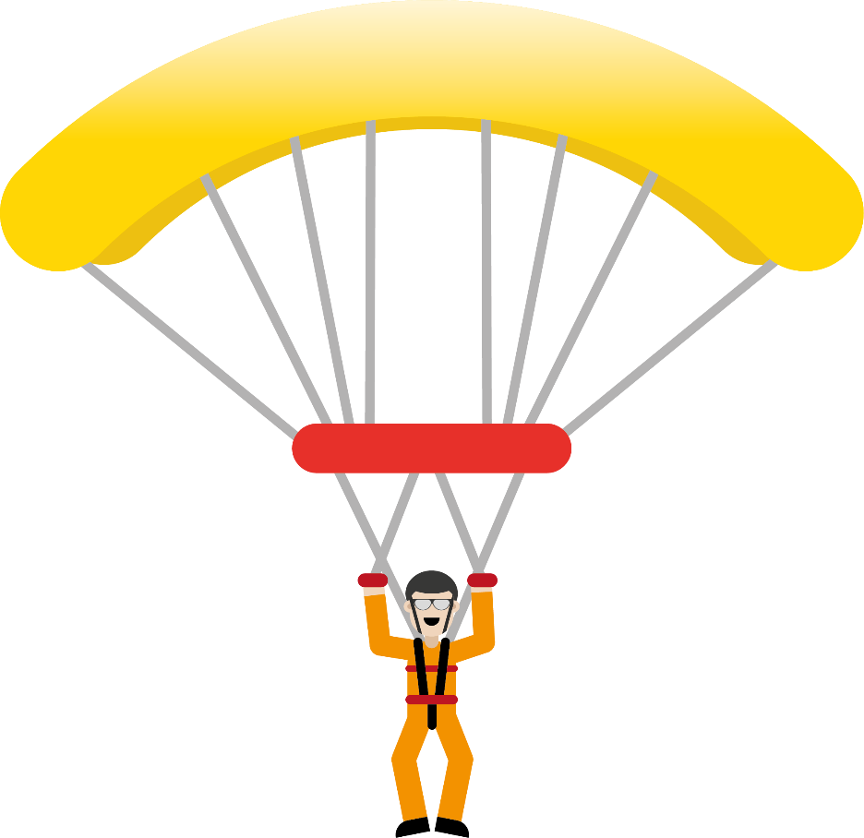
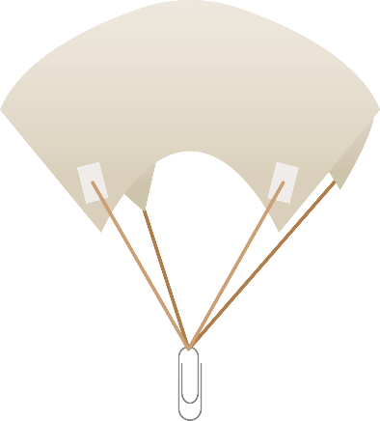
Think like a Scientist
Who do you agree with?
The mass of an object affects the amount of air resistance.
Jane
Air resistance is the same as gravity.
The larger the surface area, the more air resistance.
Alfie
Marlon
©Deepening Understanding LTD 2020

Slide 17
Exit task – Checking the tricky bits
Let’s try answering Jerry’s question again…
What is the same and what is different about gravity and air resistance?
©Deepening Understanding LTD 2020

