Slide 1
Year 5 – Autumn Block 5 – Perimeter and Area – Area of Rectangles
About This Resource:
This PowerPoint has been designed to support your teaching of this small step. It includes a starter activity and an example of each question from the Varied Fluency and Reasoning and Problem Solving resources also provided in this pack. You can choose to work through all examples provided or a selection of them depending on the needs of your class.
National Curriculum Objectives:
Mathematics Year 5: (5M7b) Calculate and compare the area of rectangles (including squares), and including using standard units, square centimetres (cm2) and square metres (m2) and estimate the area of irregular shapes
More resources which follow the same small steps as White Rose.
Did you like this resource? Don’t forget to review it on our website.
© Classroom Secrets Limited 2018

Slide 2
Year 5 – Autumn Block 5 – Area and Perimeter
Step 4: Area of Rectangles
© Classroom Secrets Limited 2018

Slide 3
Introduction
All these rectangles have a perimeter of 36cm².
Find the missing lengths.
9cm
6cm
12cm
© Classroom Secrets Limited 2018

Slide 4
Introduction
All these rectangles have a perimeter of 36cm².
Find the missing lengths.
3cm
9cm
6cm
4cm
12cm
6cm
© Classroom Secrets Limited 2018

Slide 5
Varied Fluency 1
Complete the shape so that the rectangle has an area of 40cm².
© Classroom Secrets Limited 2018

Slide 6
Varied Fluency 1
Complete the shape so that the rectangle has an area of 40cm².
5cm x 8cm = 40cm²
© Classroom Secrets Limited 2018

Slide 7
Varied Fluency 2
The area of this rectangle is 24cm². True or false?
8cm
4cm
© Classroom Secrets Limited 2018

Slide 8
Varied Fluency 2
The area of this rectangle is 24cm². True or false?
False, the correct answer is 32cm².
8cm
4cm
© Classroom Secrets Limited 2018

Slide 9
Varied Fluency 3
Find the area of these rectangles.
A
B
12cm
3.5cm
5cm
6cm
© Classroom Secrets Limited 2018

Slide 10
Varied Fluency 3
Find the area of these rectangles.
A = 12cm x 6cm = 72cm² B = 5cm x 3.5cm = 17.5cm²
A
B
12cm
3.5cm
5cm
6cm
© Classroom Secrets Limited 2018

Slide 11
Varied Fluency 4
Match the shape to the correct area.
4cm
B
A
2.5cm
9cm
81cm²
25.4cm²
10cm²
© Classroom Secrets Limited 2018

Slide 12
Varied Fluency 4
Match the shape to the correct area.
4cm
B
A
2.5cm
9cm
81cm²
25.4cm²
10cm²
© Classroom Secrets Limited 2018

Slide 13
Problem Solving 1
Using the information, calculate the area of the larger rectangle.
?
25cm
Area = 50cm²
?
?
Area = ?
The larger rectangle has sides that are twice as long as the smaller one.
© Classroom Secrets Limited 2018

Slide 14
Problem Solving 1
Using the information, calculate the area of the larger rectangle.
The smaller rectangle has sides of 25cm x 2cm.
The larger rectangle has sides of 50cm x 4cm.
Area of larger rectangle = 200cm².
?
25cm
Area = 50cm²
?
?
Area = ?
The larger rectangle has sides that are twice as long as the smaller one.
© Classroom Secrets Limited 2018

Slide 15
Problem Solving 2
This rectangle has an area of 48cm². What could the dimensions be? Include a range of possible answers.
Area = 48cm²
© Classroom Secrets Limited 2018

Slide 16
Problem Solving 2
This rectangle has an area of 48cm². What could the dimensions be? Include a range of possible answers.
Various answers, for example:
8cm x 6cm, 24cm x 2cm, 12cm x 4cm
Area = 48cm²
© Classroom Secrets Limited 2018

Slide 17
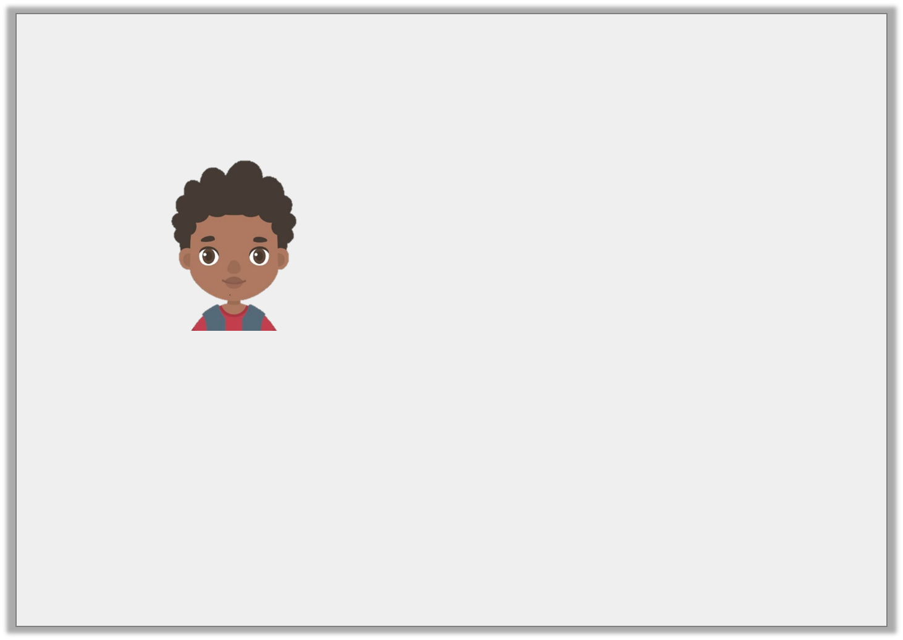
Reasoning 1
Max says,
Explain Max’s mistake.
The area of this rectangle is 36cm².
9cm
© Classroom Secrets Limited 2018

Slide 18
Reasoning 1
Max says,
Explain Max’s mistake.
Max has realised that the shape is a square, but…
The area of this rectangle is 36cm².
9cm
© Classroom Secrets Limited 2018

Slide 19
Reasoning 1
Max says,
Explain Max’s mistake.
Max has realised that the shape is a square, but he has added together all the sides instead of multiplying them.
The correct answer is 9cm x 9cm = 81cm².
The area of this rectangle is 36cm².
9cm
© Classroom Secrets Limited 2018

