Slide 1
Step 2: Calculate Perimeter
© Classroom Secrets Limited 2018

Slide 2
Introduction
Calculate the perimeter of these shapes, and order them from smallest to largest.
5cm
12cm
14cm
A
8cm
C
B
7cm
18cm
© Classroom Secrets Limited 2018

Slide 3
Introduction
Calculate the perimeter of these shapes, and order them from smallest to largest.
A, C, B
5cm
12cm
14cm
A
8cm
C
B
7cm
18cm
40cm
42cm
46cm
© Classroom Secrets Limited 2018

Slide 4
Varied Fluency 1
Match the shape to the correct perimeter.
2cm
12cm
10cm
A
8.5cm
15cm
6.5cm
5cm
3cm
B
10 | 3 | cm
 | 4
58cm
54cm
35.75cm
© Classroom Secrets Limited 2018

Slide 5
Varied Fluency 1
Match the shape to the correct perimeter.
2cm
12cm
10cm
A
8.5cm
11.5cm
15cm
6.5cm
5cm
3cm
B
18.5cm
10 | 3 | cm
 | 4
54cm
35.75cm
58cm
© Classroom Secrets Limited 2018

Slide 6
Varied Fluency 2
Calculate the perimeter.
7.5cm
14.5cm
6cm
18cm
© Classroom Secrets Limited 2018

Slide 7
Varied Fluency 2
Calculate the perimeter.
10.5cm
8.5cm
7.5cm
14.5cm
6cm
18cm
65cm
© Classroom Secrets Limited 2018

Slide 8
Varied Fluency 3
True or false? The perimeter of these shapes is the same.
14cm
13.5cm
2cm
B
8cm
A
14cm
14cm
14cm
8cm
7cm
7cm
2cm
14cm
2cm
© Classroom Secrets Limited 2018

Slide 9
Varied Fluency 3
True or false? The perimeter of these shapes is the same.
False; A has a perimeter of 72cm and B has a perimeter of 69cm.
14cm
13.5cm
2cm
B
8cm
A
14cm
14cm
14cm
8cm
7cm
7cm
2cm
14cm
2cm
© Classroom Secrets Limited 2018

Slide 10
Varied Fluency 4
Tick the shape(s) with a perimeter of 50cm.
4cm
3cm
12cm
8.5cm
5cm
17.75cm
14cm
15.5cm
A
4cm
B
C
9cm
10 | 1 | cm
 | 2
6cm
© Classroom Secrets Limited 2018

Slide 11
Varied Fluency 4
Tick the shape(s) with a perimeter of 50cm.
4cm
3cm
12cm
8.5cm
5cm
17.75cm
14cm
15.5cm
A
4cm
B
C
9cm
10 | 1 | cm
 | 2
6cm

© Classroom Secrets Limited 2018

Slide 12
Problem Solving 1
This shape has been made using identical squares.
The middle square has a perimeter of 16cm.
What is the perimeter of the whole shape?
© Classroom Secrets Limited 2018

Slide 13
Problem Solving 1
This shape has been made using identical squares.
The middle square has a perimeter of 16cm.
What is the perimeter of the whole shape? 48cm
4cm
4cm
© Classroom Secrets Limited 2018

Slide 14
Problem Solving 2
A farmer needs to increase the size of his corn field. Currently his field is square shaped and has a perimeter of 60m. It needs to be turned into a rectangle with a perimeter of 90m.
What could the dimensions of the new corn field be?
© Classroom Secrets Limited 2018

Slide 15
Problem Solving 2
A farmer needs to increase the size of his corn field. Currently his field is square shaped and has a perimeter of 60m. It needs to be turned into a rectangle with a perimeter of 90m.
Possible answer:
40m + 40m + 5m + 5m
What could the dimensions of the new corn field be?
© Classroom Secrets Limited 2018

Slide 16
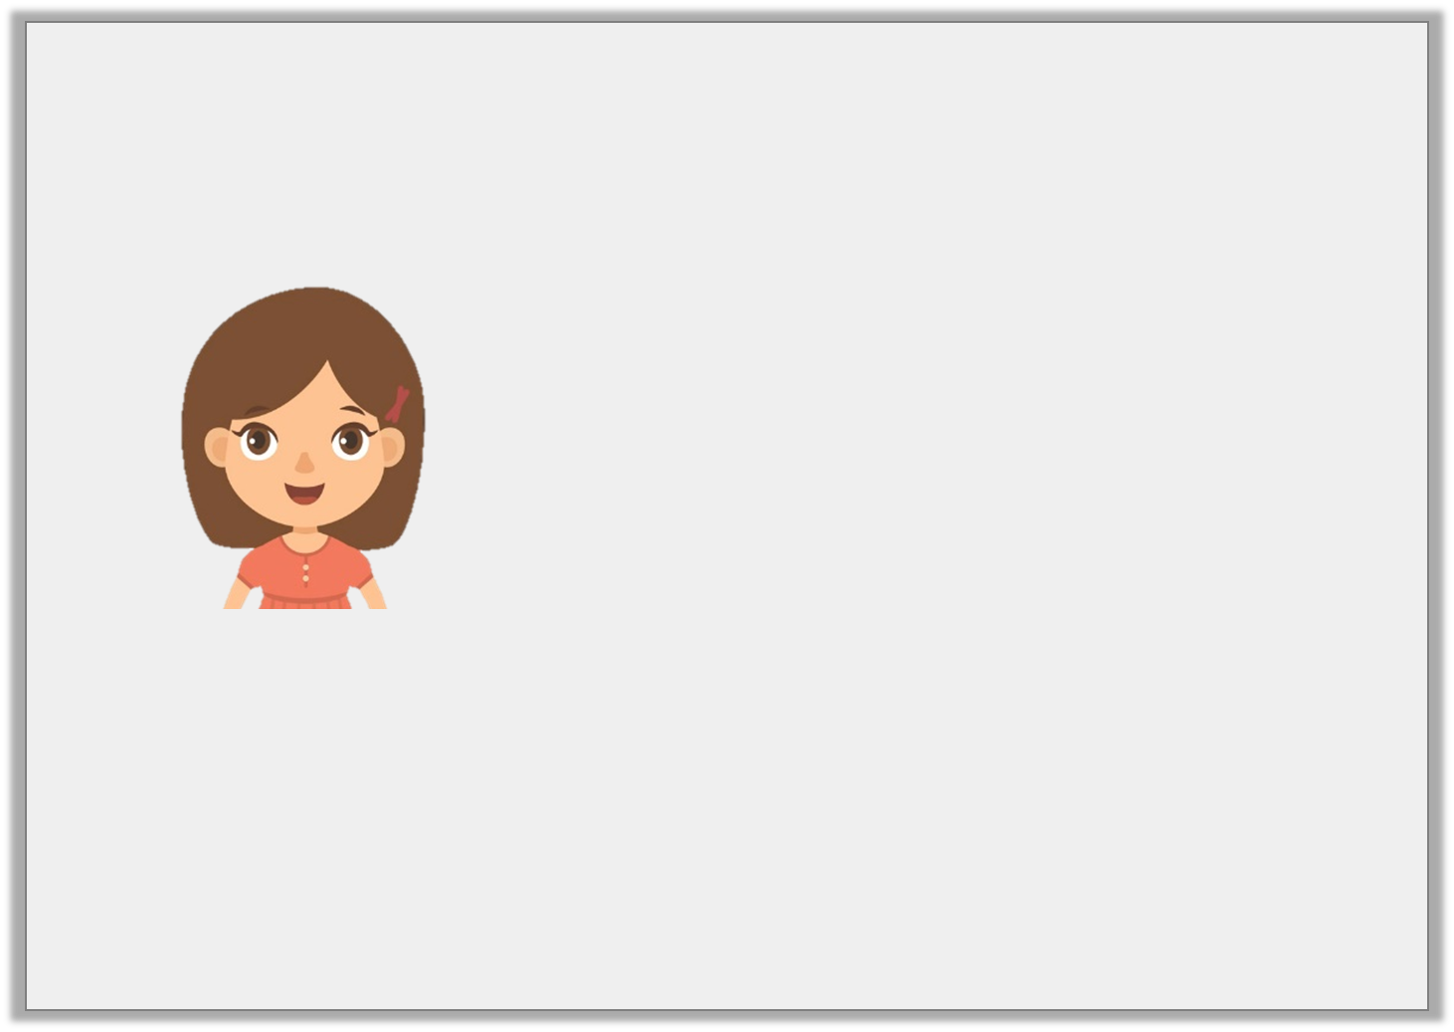
Reasoning 1
Crystal says,
Is Crystal right? Explain your answer.
7 | 1 | m
 | 2
The perimeter is 55m.
20m
7.5m
20m
© Classroom Secrets Limited 2018

Slide 17
Reasoning 1
Crystal says,
Is Crystal right? Explain your answer.
Crystal is not correct because…
7 | 1 | m
 | 2
The perimeter is 55m.
20m
7.5m
20m
© Classroom Secrets Limited 2018

Slide 18
Reasoning 1
Crystal says,
Is Crystal right? Explain your answer.
Crystal is not correct because the missing sides are 12.5m and 12.5m. Added together, the perimeter is 80m.
7 | 1 | m
 | 2
The perimeter is 55m.
20m
7.5m
20m
© Classroom Secrets Limited 2018

