Slide 1
Week 4 Session 1
Mental Strategies Answers
Q | Question | Answer
1 | 3 + 2 | 5
2 | ☐ + 25 = 100 | 75
3 | What is half of 8? | 4
4 | 150 − 10 | 140
5 | 191 + ☐ = 210 | 19
6 | 97 = 60 + ☐ | 37
7 | 135 − 132 | 3
8 | 5 × 8 = 40, so 40 ÷ 5 = ☐ | 8
9 | Write 20:11 in 12 hour clock format | 8:11 pm
10 | 07:52 is how many minutes after 07:06? | 46

Slide 2
Week 4 Session 1
Timestables Answers
Q | Question | Answer
1 | 2 × 7 = ☐ | 14
2 | 6 ÷ 3 = ☐ | 2
3 | 3 × ☐ = 21 | 7
4 | 56 ÷ ☐ = 8 | 7
5 | 10 × 9 = ☐ | 90
6 | 30 ÷ 10 = ☐ | 3
7 | ☐ × 4 = 16 | 4
8 | ☐ ÷ 9 = 6 | 54
9 | 10 × 8 = ☐ | 80
10 | 90 ÷ 10 = ☐ | 9

Slide 3
Week 4 Session 1
Key Skills Answers
Q | Question | Answer
1 | What is 3/9 of 54? | 18
2 | 964 × 9 | 8676
3 | 1444 − 982 | 462
4 | 3.2 × 8.25 | 26.4
5 | 8/10 as a decimal number | 0.8
6 | 82.23 + 7.27 | 89.5
7 | 36 ÷ (−6) | −6
8 | If a = 1 b = 3 and c = 4, what is the value of 4b³ ? | 108
9 | 10 − (−9) | 19
10 | Is 5 a factor of 21? | No

Slide 4
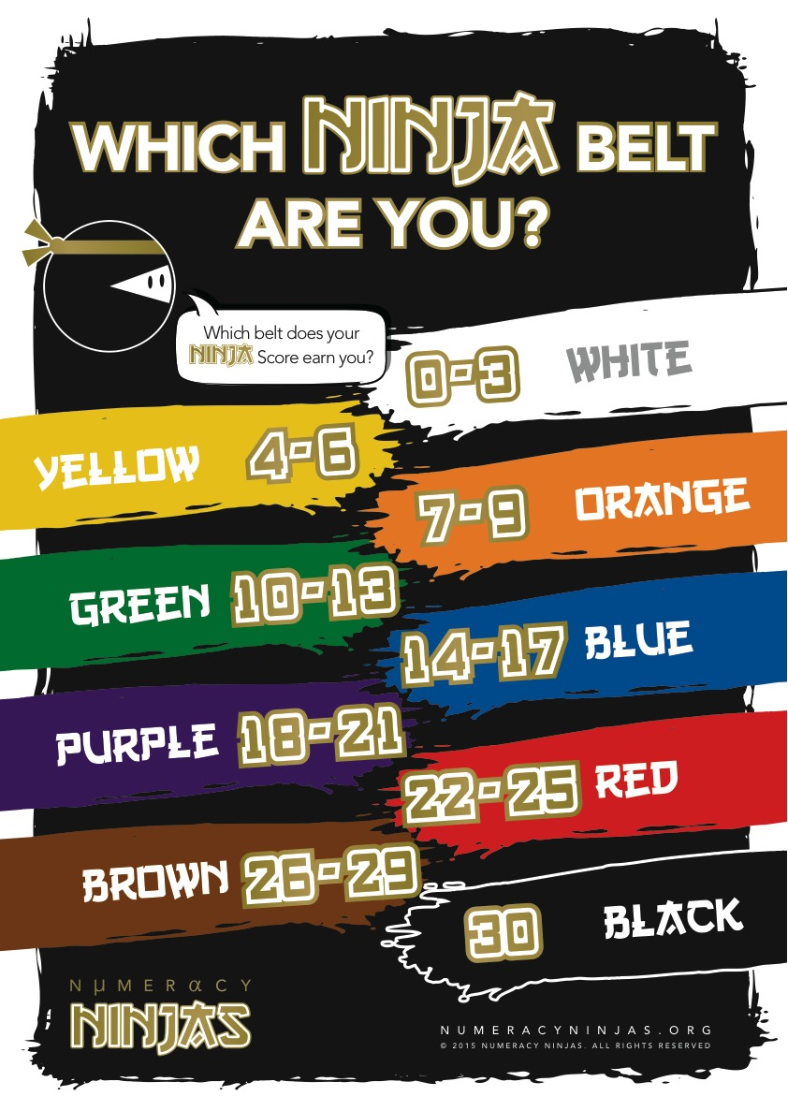
Week 4 Session 1
Calculate your Ninja Score to see which Ninja Belt you’ve earned today!

Slide 5
Week 5 Session 1
Mental Strategies Answers
Q | Question | Answer
1 | ☐ + 9 = 10 | 1
2 | What is double 6? | 12
3 | Halve 24 | 12
4 | 143 + 60 | 203
5 | 94 + 97 | 191
6 | 41 + 10 = 41 + 9 + ☐ | 1
7 | 1 + 700 | 701
8 | 31 + 47 = 30 + 40 + ☐ | 8
9 | What is double 56? | 112
10 | What is half of 4? | 2

Slide 6
Week 5 Session 1
Timestables Answers
Q | Question | Answer
1 | 7 × 10 = ☐ | 70
2 | 21 ÷ 3 = ☐ | 7
3 | 3 × ☐ = 18 | 6
4 | 5 ÷ ☐ = 1 | 5
5 | 1 × 2 = ☐ | 2
6 | 30 ÷ 3 = ☐ | 10
7 | ☐ × 2 = 8 | 4
8 | ☐ ÷ 3 = 6 | 18
9 | 3 × 6 = ☐ | 18
10 | 63 ÷ 7 = ☐ | 9

Slide 7
Week 5 Session 1
Key Skills Answers
Q | Question | Answer
1 | What is 25% of £190? | £47.50
2 | 6146 ÷ 7 | 878
3 | 4 + 5 × 1 | 9
4 | 462.2 ÷ 5 | 92.44
5 | 1000 × 0.64 | 640
6 | 69.12 − 9.2 | 59.92
7 | Write 35/49 in its simplest form | 5/7
8 | 10 − 10 | 0
9 | See number line | 13
10 | What is the lowest common multiple of 6 and 8? | 24

Slide 8
Week 5 Session 1
Calculate your Ninja Score to see which Ninja Belt you’ve earned today!

