Slide 1
Progression in Mastery
Year 6 Classify Living Things
Let’s challenge ourselves to classify living things!
©Deepening Understanding LTD 2020

Slide 2
Remember the Science
Living things can be classified into different groups.
Can you name the different groups using the images above?
plants
animals
©Deepening Understanding LTD 2020

Slide 3
Talk like a Scientist
Discuss Jerry’s question with your partner.
In what other ways could we group plants and animals?
We need to look at the characteristics of each group.
©Deepening Understanding LTD 2020

Slide 4
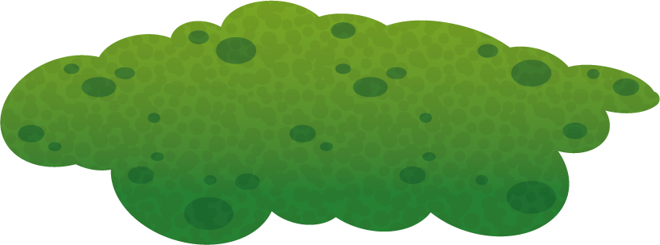
Remember the Science
Plants can be classified into smaller groups.
Can you name the different groups using the images above?
flowering plants
non-flowering plants
©Deepening Understanding LTD 2020

Slide 5
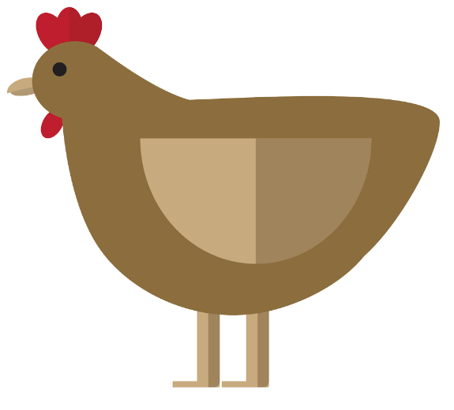
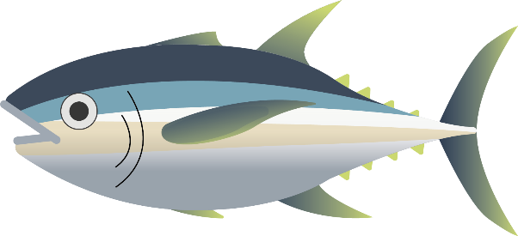
Remember the Science
Animals can be classified into smaller groups.
Can you name the different groups using the images above?
mammals
amphibians
reptiles
fish
birds
©Deepening Understanding LTD 2020

Slide 6
Know the Science
Plants
Flowering plants…
Can you name some types of flowering plants?
produce seeds which grow as separate plants by developing roots.
rely on animals and wind to spread pollen to produce new seeds.
©Deepening Understanding LTD 2020

Slide 7
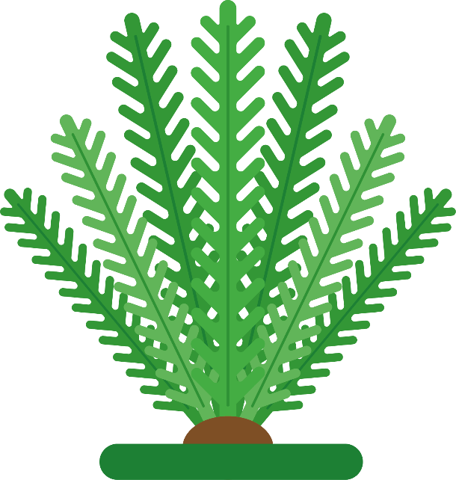
Know the Science
Plants
Non-flowering plants…
Can you name some types of non-flowering plants?
do not produce seeds; they produce spores on their leaves.
The spores fall close to where the parent plant grew and develop roots.
©Deepening Understanding LTD 2020

Slide 8
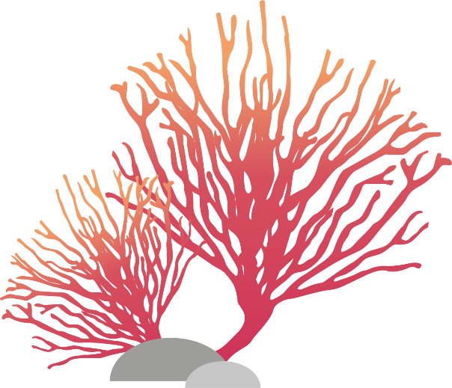
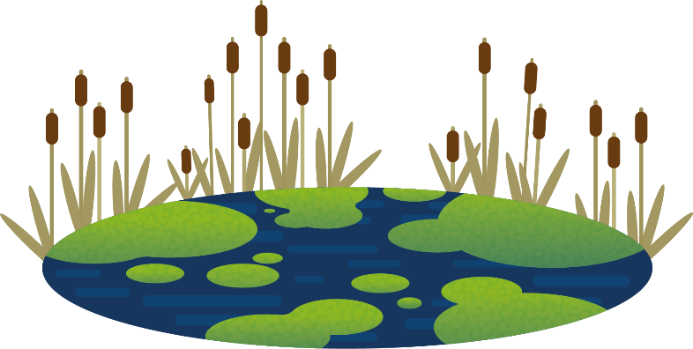
Talk like a Scientist
Can you sort these plants into flowering and non-flowering plants?
Can you think of any other plants to add to your lists?
©Deepening Understanding LTD 2020

Slide 9
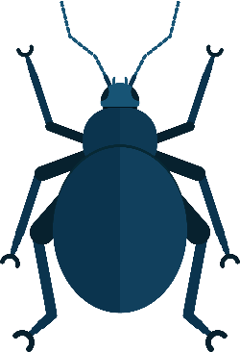
Remember the Science
Animals
Animals are broadly classified into 2 groups.
Can you name any examples of vertebrates and invertebrates?
vertebrates
invertebrates
They have a backbone inside their body.
They do not have a backbone; they have soft bodies or an outer shell.
©Deepening Understanding LTD 2020

Slide 10
Know the Science
Microorganisms are very small living things.
We can only see them using a microscope.
©Deepening Understanding LTD 2020

Slide 11
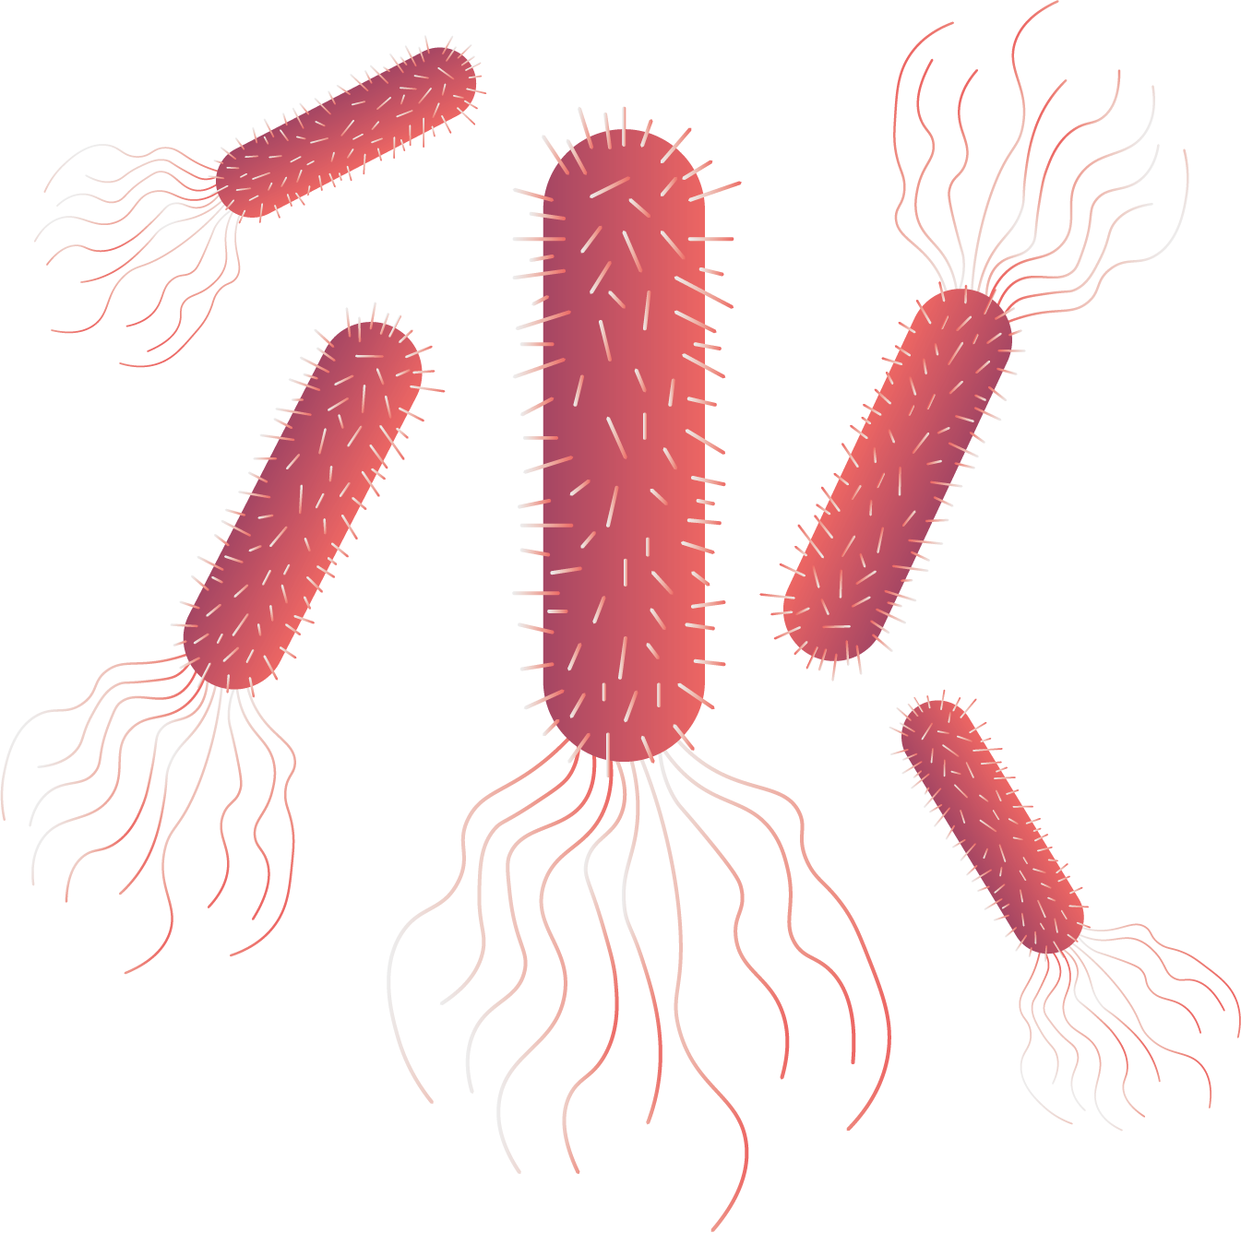
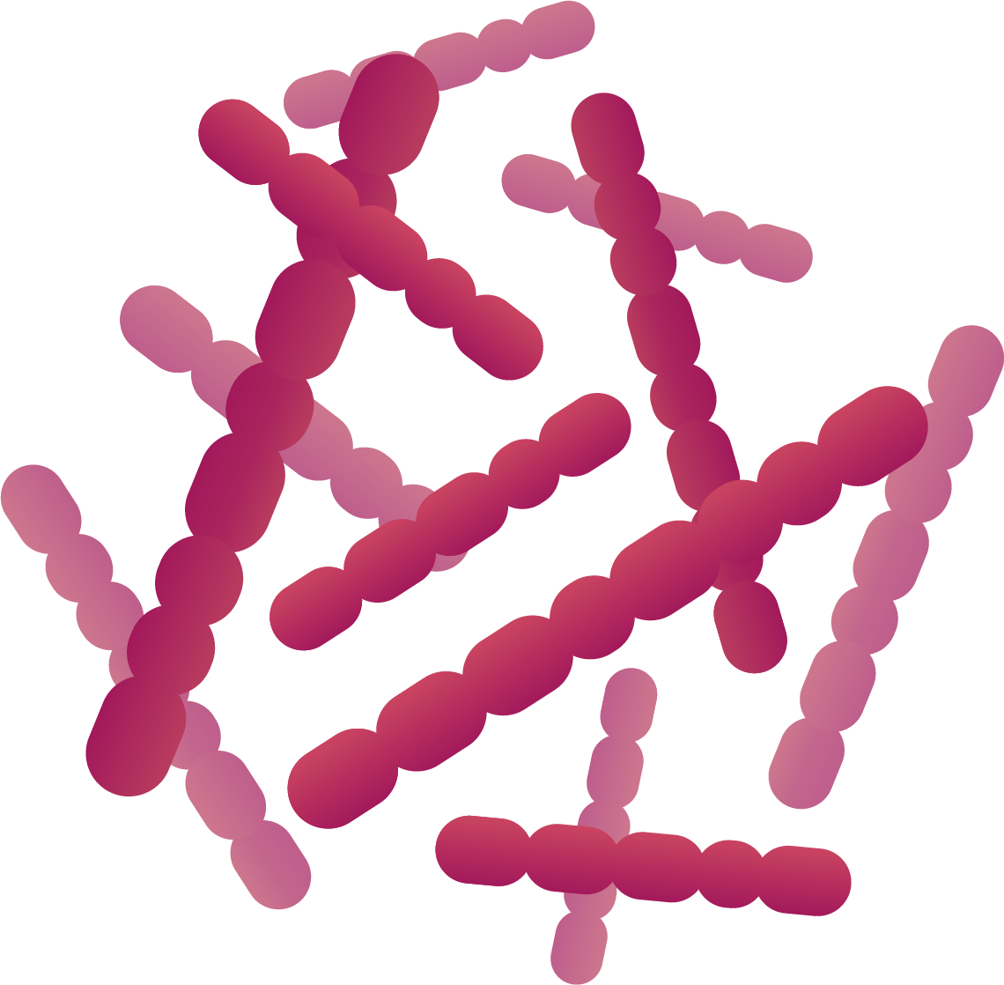
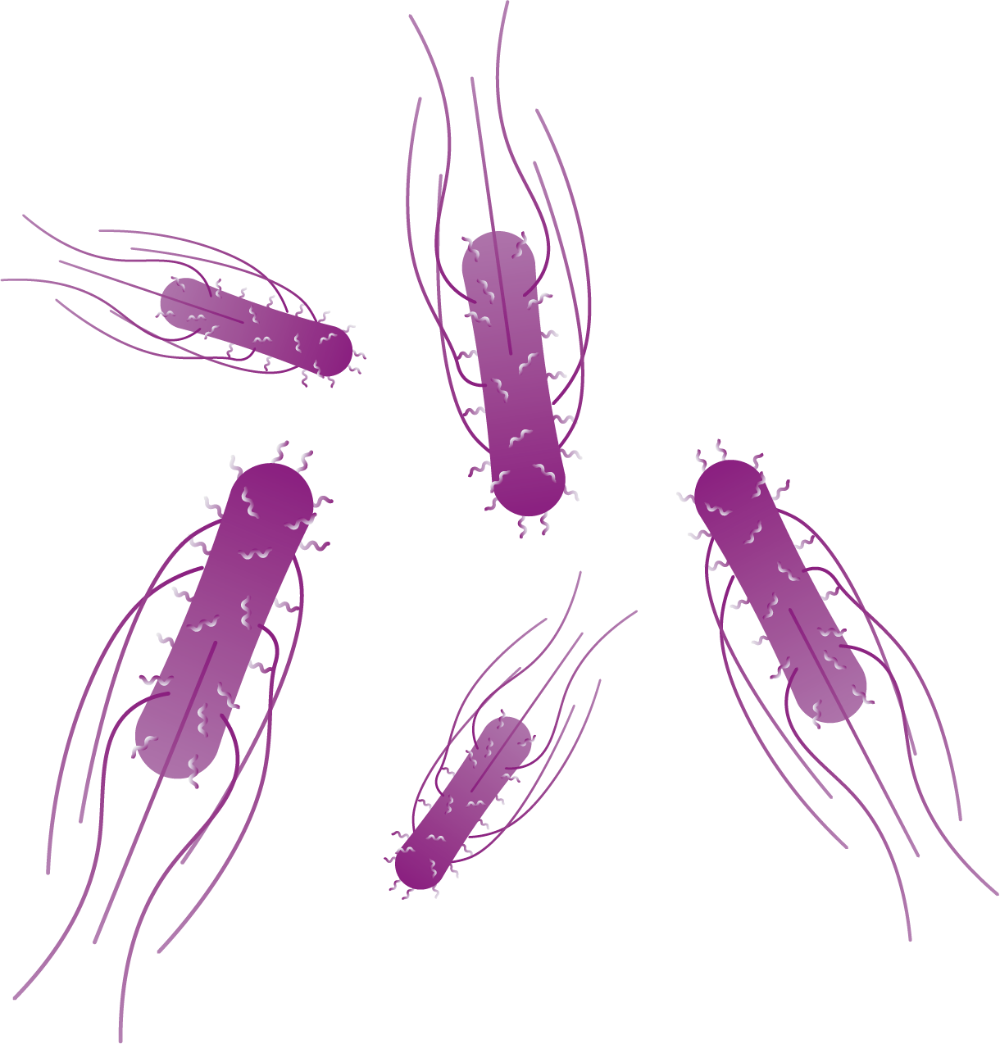
Know the Science
Bacteria is a microorganism which breaks down plants into nutrients.
We sometimes refer to microorganisms as ‘germs’.
Harmful germs can make us unwell.
©Deepening Understanding LTD 2020

Slide 12
Talk like a Scientist
Discuss Jerry’s question with your partner.
What can we do to prevent the spread of harmful germs?
©Deepening Understanding LTD 2020

Slide 13
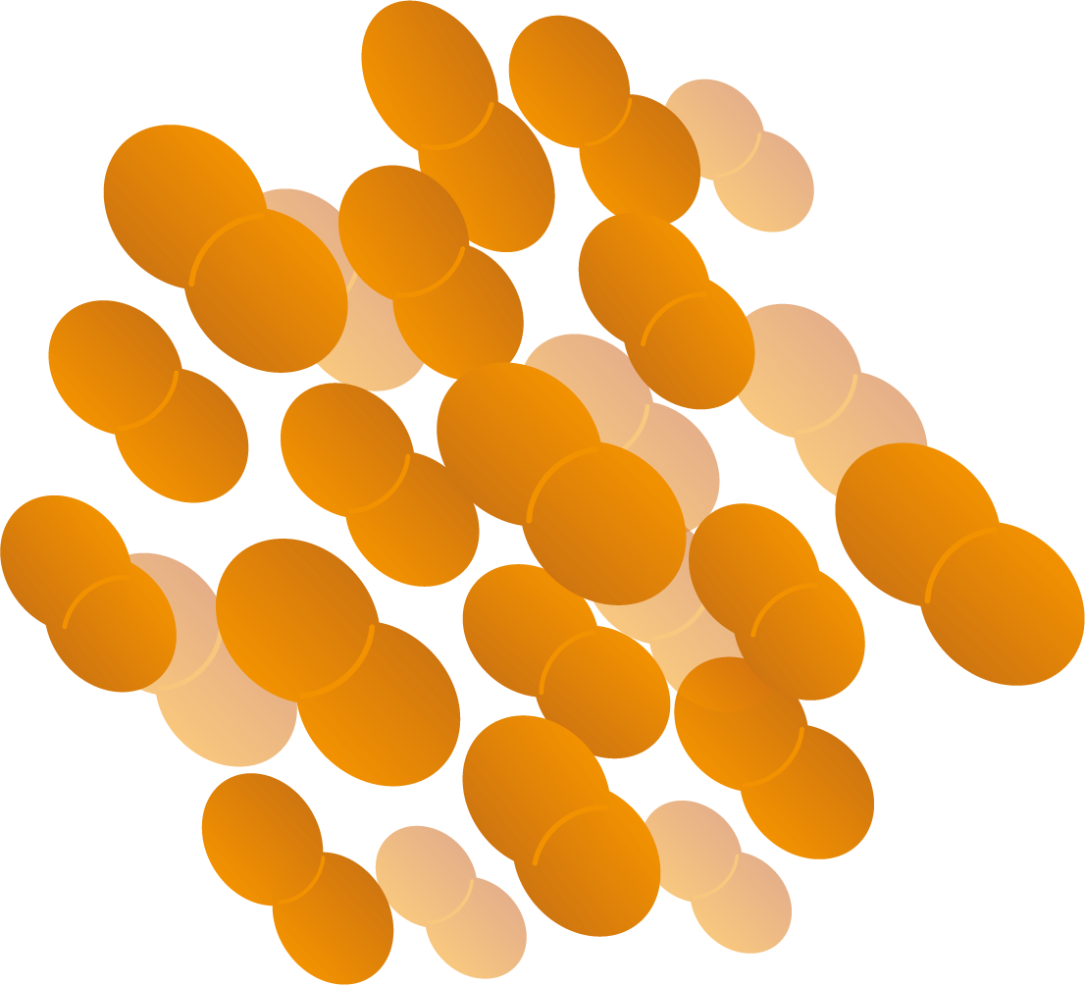
Know the Science
Bacteria can be helpful to us too...
Yeast, for example, is used when baking bread to help it rise.
Lactococcus lactis is used in the production of buttermilk and cheese.
©Deepening Understanding LTD 2020

Slide 14
Independent Task
Become a Scientist
©Deepening Understanding LTD 2020

Slide 15
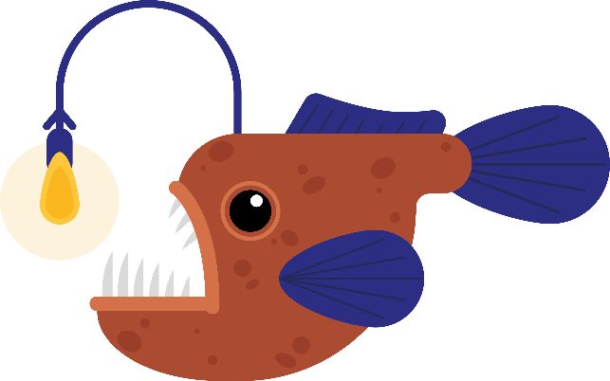
Exit task – Checking the tricky bits
Jerry thinks that these animals are from the same class of animals.
Do you agree with him? Explain your reasoning.
©Deepening Understanding LTD 2020

