Slide 1
Progression in Mastery
Year 6 Classification of Living Things by Scientists
Let’s learn how famous scientists classify!
©Deepening Understanding LTD 2020

Slide 2
Remember the Science
We can group plants into flowering plants and non-flowering plants.
Can you name any examples of flowering and non-flowering plants?
Flowering plants produce ______ which grow as separate plants by developing roots.
Non-flowering plants do not produce ______. Instead, they produce ______ on their leaves.
©Deepening Understanding LTD 2020

Slide 3
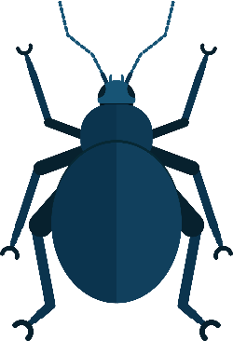
Remember the Science
Animals can be broadly classified into two groups.
Can you name any examples of vertebrates and invertebrates?
Vertebrates have a ________ inside their body.
Invertebrates do not have a ________. They have soft bodies or an outer ________.
©Deepening Understanding LTD 2020

Slide 4
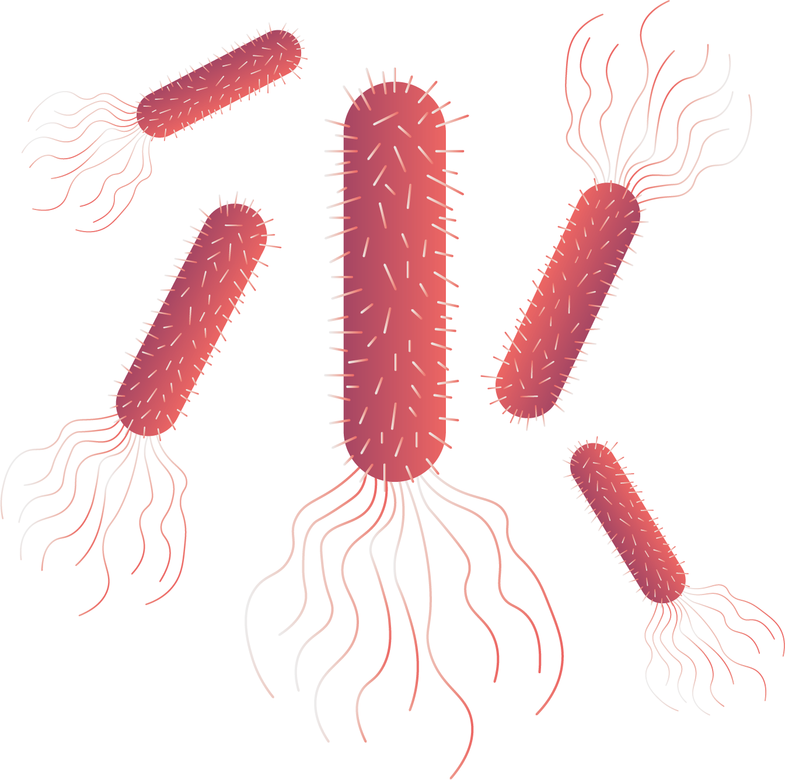
Remember the Science
Microorganisms are very small living things.
We can only see them using a ________.
Can you remember the name of any helpful bacteria?
Bacteria is a microorganism which breaks down plants into ________.
We sometimes refer to microorganisms as ‘________’. Harmful ________ can make us ill.
©Deepening Understanding LTD 2020

Slide 5
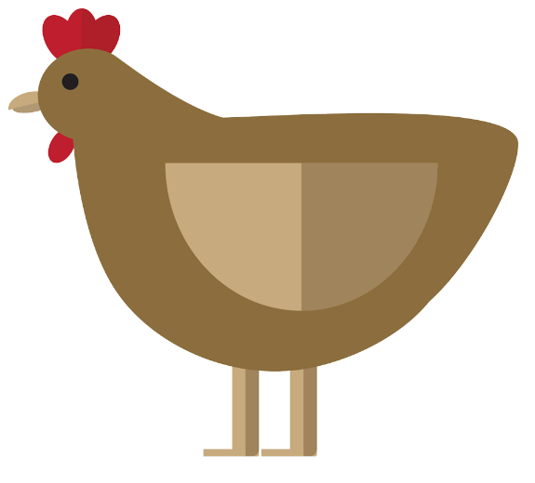
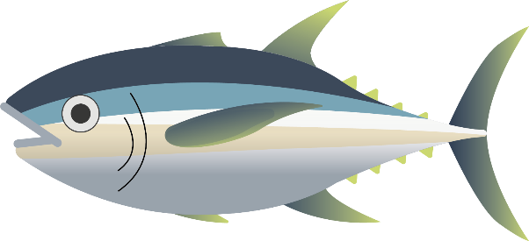
Know the Science
Scientists, known as taxonomists, classify living things based on their similarities and differences.
©Deepening Understanding LTD 2020

Slide 6
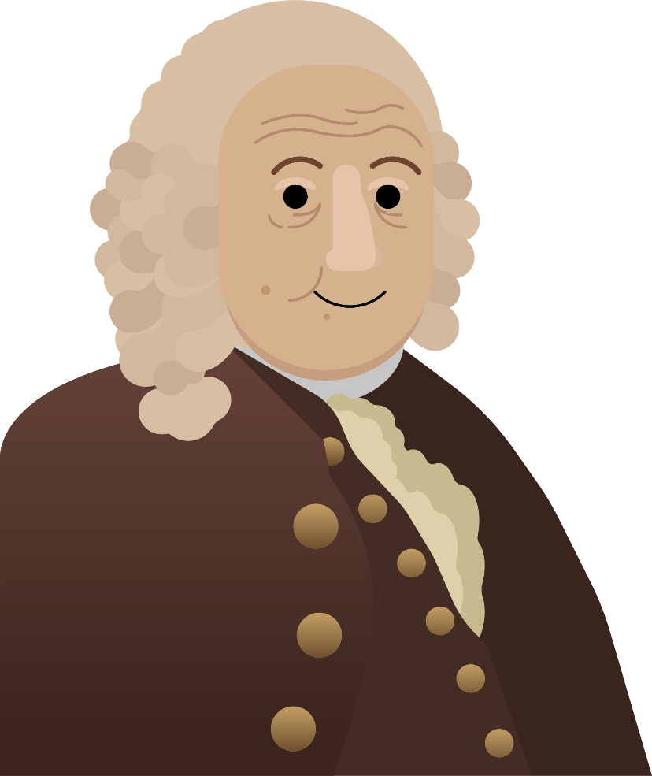
Know the Science
Carl Linnaeus, a Swedish taxonomist, published a
system for classifying all living things in 1735. We still
use an adapted version of this today.
It is known as the Linnaean System.
©Deepening Understanding LTD 2020

Slide 7
Act like a Scientist
There were eight different levels to Linnaeus’ classification system.
Research the meaning of each of these terms.
Domain
Kingdom
Phylum
Class
Order
Family
Genus
Species
©Deepening Understanding LTD 2020

Slide 8
Talk like a Scientist
Discuss Jane’s question with your partner…
Can you name all of the kingdoms used in classification?
©Deepening Understanding LTD 2020

Slide 9
Think like a Scientist
Who do you agree with?
Lions and tigers are the same species.
Millie
Dogs and wolves are in the same family.
Sharks and whales are the same class.
Anita
Caleb
©Deepening Understanding LTD 2020

Slide 10
Independent Task
Become a Scientist
©Deepening Understanding LTD 2020

Slide 11
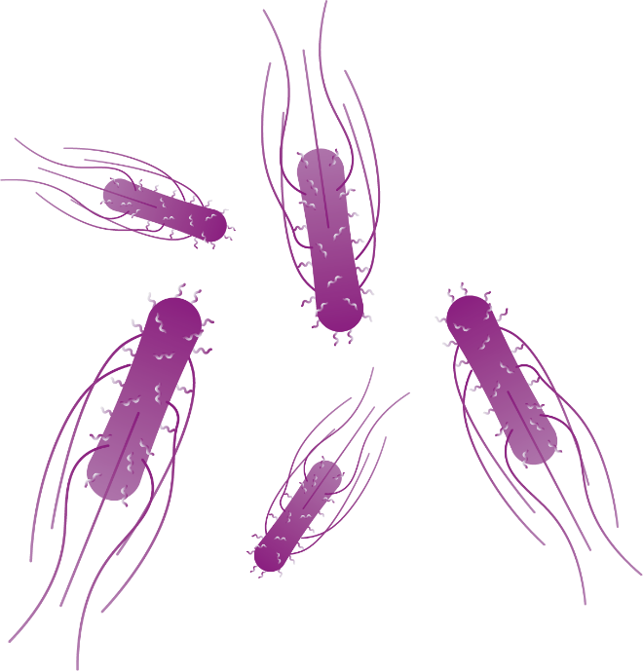
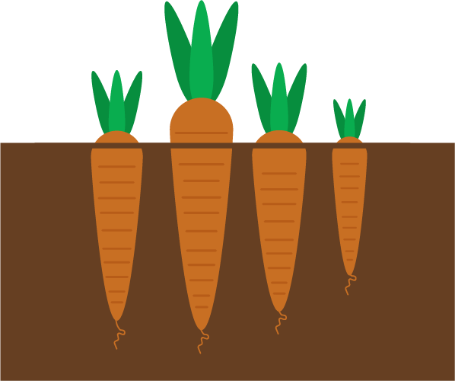
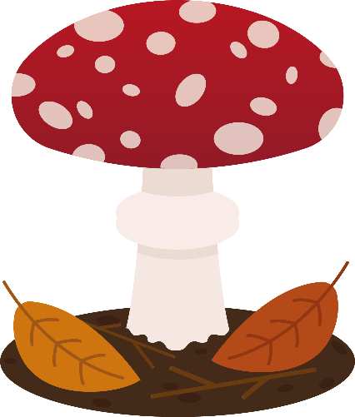
Exit task – Checking the tricky bits
Jane thinks that these living things are from the same kingdom.
Do you agree with her? Explain your reasoning.
©Deepening Understanding LTD 2020

