Slide 1
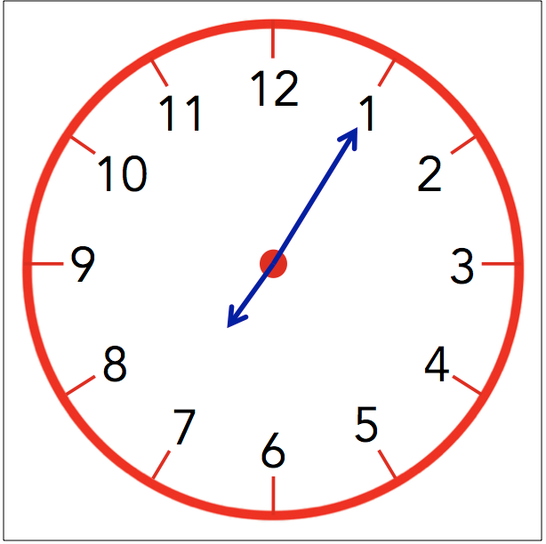
Week 6 Session 1
Mental Strategies Answers
Q | Question | Answer
1 | 17 + ☐ = 20 | 3
2 | What is double 36? | 72
3 | 89 + 10 | 99
4 | 143 − 20 | 123
5 | 5 = 4 + ☐ | 1
6 | 14 − 7 = 14 − 4 − ☐ | 3
7 | 56 + 56 = ☐ × 56 | 2
8 | Draw hands on the clock face showing 7:05 pm | See clock above
9 | What is double 9? | 18
10 | Halve 48 | 24

Slide 2
Week 6 Session 1
Timestables Answers
Q | Question | Answer
1 | 5 × 10 = ☐ | 50
2 | 18 ÷ 6 = ☐ | 3
3 | 9 × ☐ = 63 | 7
4 | 32 ÷ ☐ = 4 | 8
5 | 5 × 9 = ☐ | 45
6 | 3 ÷ 3 = ☐ | 1
7 | ☐ × 3 = 24 | 8
8 | ☐ ÷ 3 = 10 | 30
9 | 1 × 3 = ☐ | 3
10 | 10 ÷ 5 = ☐ | 2

Slide 3
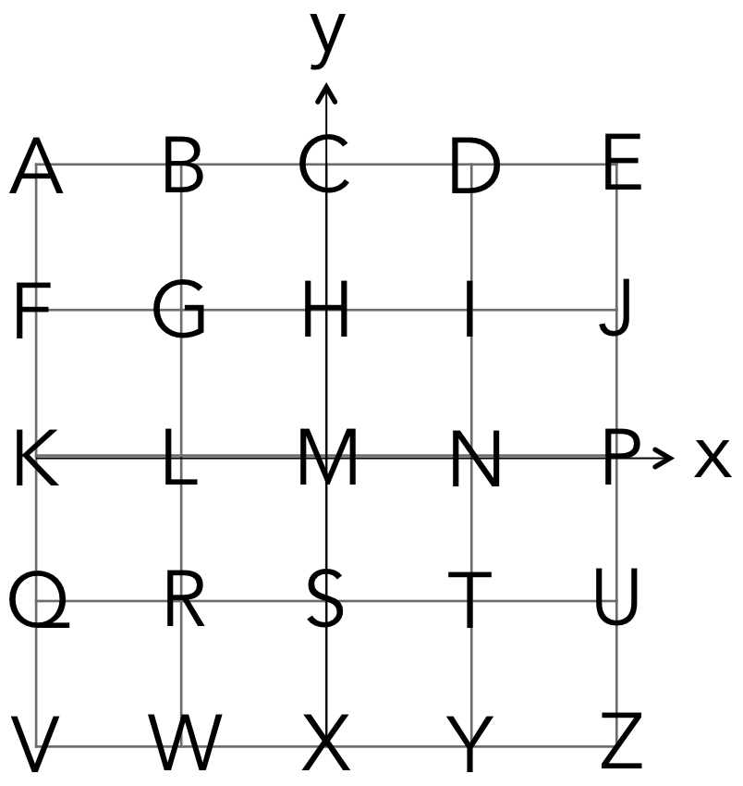
Week 6 Session 1
Key Skills Answers
Q | Question | Answer
1 | What is the value of (−15) squared? | 225
2 | 986 + 3175 | 4161
3 | √64 + 8 ÷ 8 | 9
4 | Write 780026 in words. (Use the opposite page for your answer) | Seven Hundred and Eighty Thousand and Twenty Six
5 | 13.089 ÷ 1000 | 0.013089
6 | (−1) × (−6) | 6
7 | Round 6.5254 to 2 d.p. | 6.53
8 | 10 + (−5) | 5
9 | Round 0.006435 to 1 s.f. | 0.006
10 | Letter at (−2, −2) | V

Slide 4
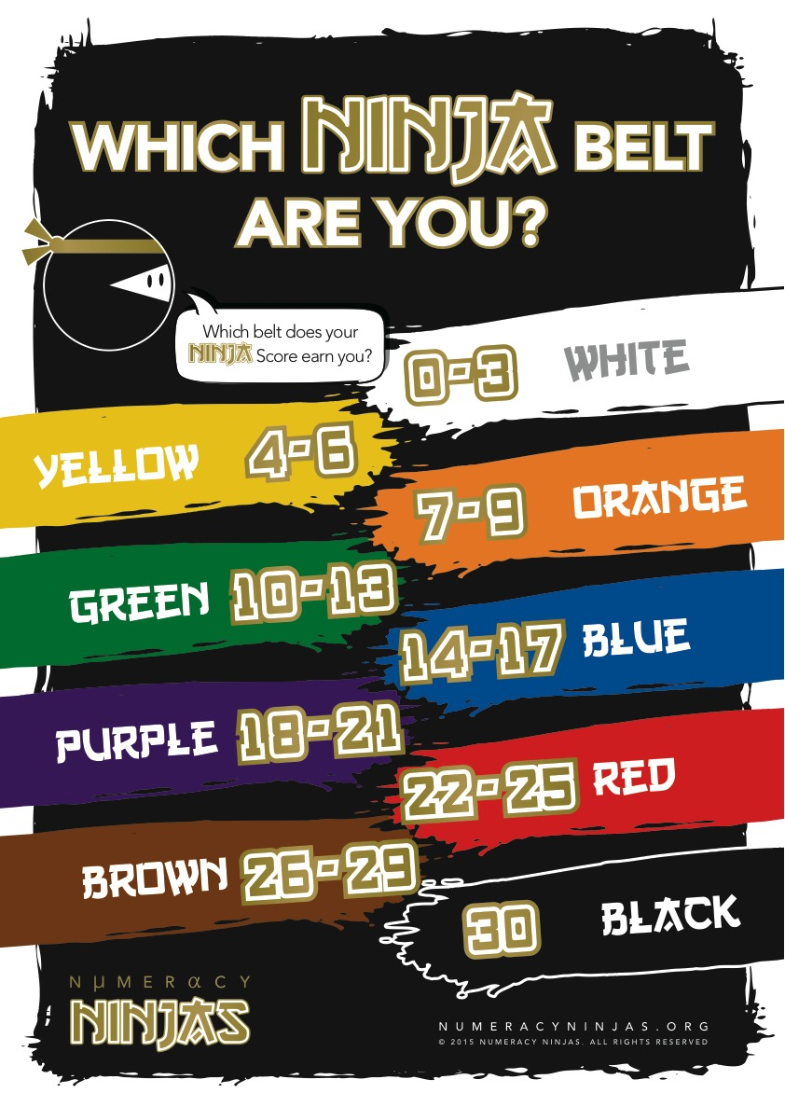
Week 6 Session 1
Calculate your Ninja Score to see which Ninja Belt you’ve earned today!

Slide 5
Week 7 Session 1
Mental Strategies Answers
Q | Question | Answer
1 | 4 + 1 | 5
2 | 66 + ☐ = 100 | 34
3 | What is half of 6? | 3
4 | 122 − 10 | 112
5 | 56 + ☐ = 90 | 34
6 | 56 = 26 + ☐ | 30
7 | 199 − 194 | 5
8 | 10 × 5 = 50, so 50 ÷ 10 = ☐ | 5
9 | Write 2:15 pm in 24 hour clock format | 14:15
10 | From 15:09, how many minutes until 15:30? | 21

Slide 6
Week 7 Session 1
Timestables Answers
Q | Question | Answer
1 | 9 × 5 = ☐ | 45
2 | 60 ÷ 6 = ☐ | 10
3 | 2 × ☐ = 16 | 8
4 | 10 ÷ ☐ = 1 | 10
5 | 9 × 10 = ☐ | 90
6 | 12 ÷ 2 = ☐ | 6
7 | ☐ × 5 = 20 | 4
8 | ☐ ÷ 4 = 6 | 24
9 | 8 × 3 = ☐ | 24
10 | 18 ÷ 6 = ☐ | 3

Slide 7
Week 7 Session 1
Key Skills Answers
Q | Question | Answer
1 | List all the factors of 2 | 2, 1
2 | What is 1/2 of 8? | 4
3 | 65 × 38 | 2470
4 | 11661 − 7509 | 4152
5 | 8.2 × 3.5 | 28.7
6 | 173.2% as a decimal number | 1.732
7 | 13 + 4.5 | 17.5
8 | 40 ÷ (−10) | −4
9 | If a = 4 b = 5 and c = 7, what is the value of 3b − 2a ? | 7
10 | 7 − (−5) | 12

Slide 8
Week 7 Session 1
Calculate your Ninja Score to see which Ninja Belt you’ve earned today!

