Slide 1
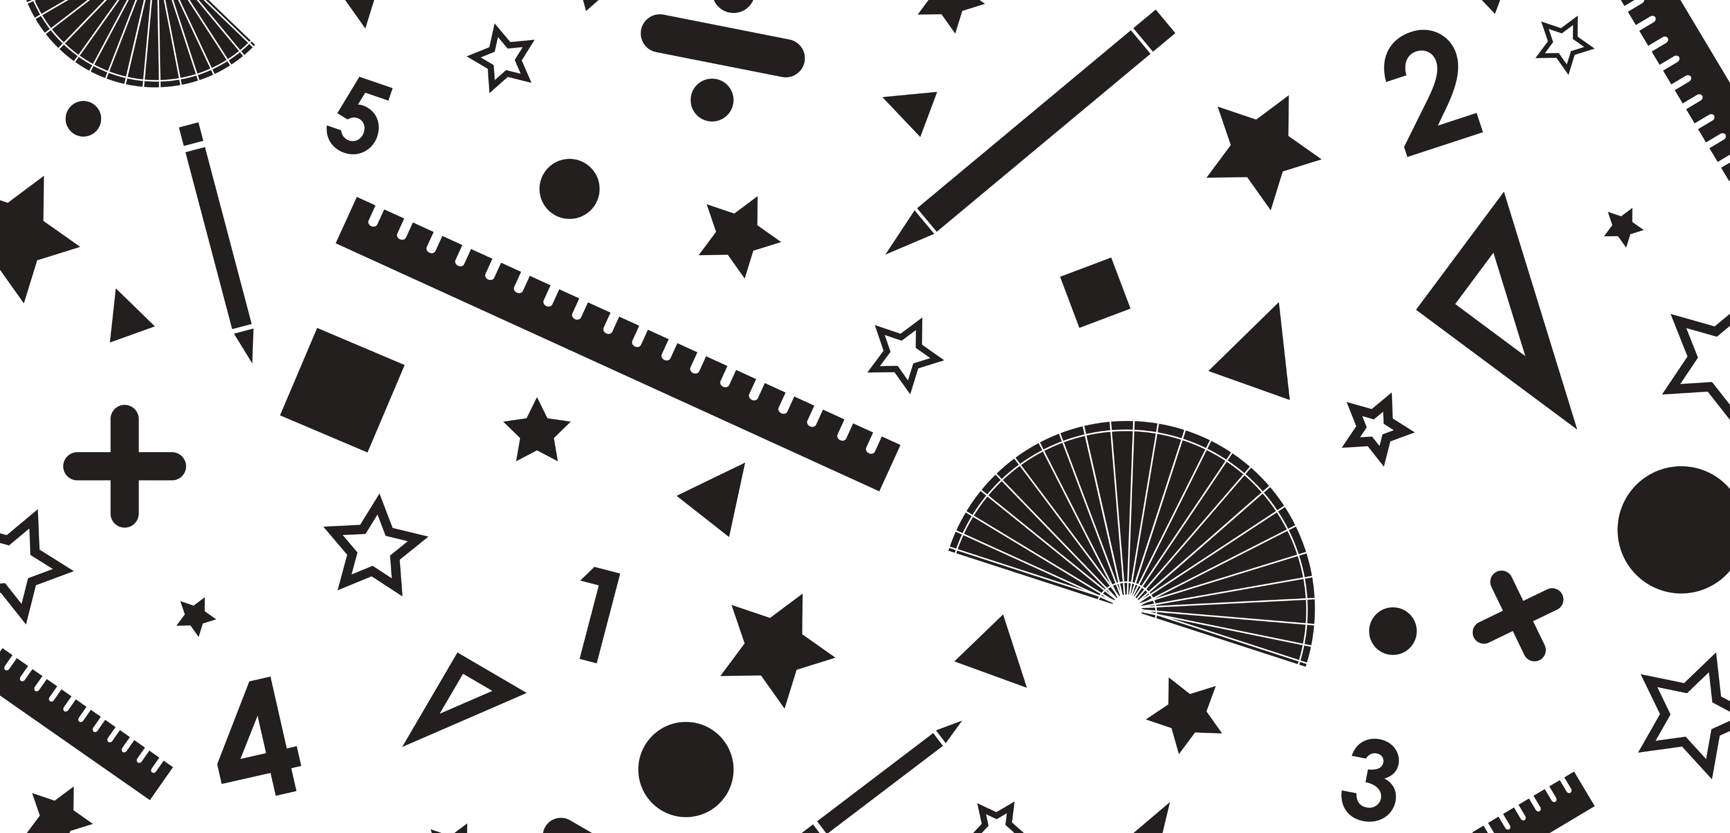
Maths Workout
Decimals Week 1
©Deepening Understanding LTD 2021

Slide 2
What fraction of the grid has been shaded?
Can you write it as a decimal?
Which number is the arrow pointing to?
One
Four
0
1
True or false?
Jane says…
Do you agree with her?
Explain your reasoning!
0.6 =
6
100
Two
“It is impossible to divide 3 by 10 because 3 is less than 10.”
There are ___ ones and ___ tenths.
The number is _____.
1
1
1
1
0.1
0.1
0.1
0.1
0.1
0.1
Three
Five
Monday
©Deepening Understanding LTD 2021

Slide 3
0.7
43
100
0.43
One
Four
False, 0.6 =
D – I do not agree with Jane.
A – It is possible to divide 3 by 10.
B – To divide numbers by 10, you move each digit one place to the right on a place value grid. If you move 3 one place to the right, you get 3 tenths. 3 ÷ 10 = 0.3
6
10
Two
There are 4 ones and 6 tenths.
The decimal number is 4.6.
Three
Five
Monday Answers
©Deepening Understanding LTD 2021

Slide 4
Divide the number below by 10.
What is the same and what is different?
5.82 5.89
One
10
10
10
10
10
10
10
1
1
1
Four
5 tenths and 7 hundredths =
4 tenths and _____ hundredths
Jerry divided 32 by 100 using a place value grid.
Has he calculated this correctly?
Convince me!
Two
T | 0 | t | h
Write the number represented by the counters.
Three
0.01
0.01
0.01
0.01
0.01
Five
0.01
0.01
0.01
Tuesday
©Deepening Understanding LTD 2021

Slide 5
7.3
They both have 5 ones and 8 tenths. They have a different number of hundredths. 5.89 is greater than 5.82.
One
Four
5 tenths and 7 hundredths =
4 tenths and 17 hundredths
D – Jerry has not calculated this correctly.
A – 32 ÷ 100 is not 3.2
B – Jerry has divided 32 by 10 because he has only moved the counters one place to the right. He should have moved them two places to the right to get the answer 0.32
Two
0.08
Three
Five
Tuesday Answers
©Deepening Understanding LTD 2021

Slide 6
Add the missing numbers to the number line.
Complete the part-whole model.
46
100
One
10
100
Four
0
0.6
1.4
2
One tenth is ____ whole split into ____ equal parts.
Which is the odd one out?
Convince me!
Two
one tenth and six hundredths
1
16
What is the same and what is different?
3.8 9.8 12.8
sixteen hundredths
0.1
0.01
0.01
0.01
0.01
0.01
0.01
Three
Five
Wednesday
©Deepening Understanding LTD 2021

Slide 7
46
100
0
0.2
0.4
0.6
0.8
1
1.2
1.4
1.6
1.8
2
One
4
10
6
100
Four
One tenth is one whole split into ten equal parts.
D – There is an odd one out.
A – is the odd one out.
B – All of the other representations are equal. They are equivalent to
, not .
Two
1
16
They all have 8 tenths. 3.8 and 9.8 are made up of ones and tenths, 12.8 is made up of tens, ones and tenths. They all have a different number of ones. 12.8 > 9.8 > 3.8
16
100
1
16
Three
Five
Wednesday Answers
©Deepening Understanding LTD 2021

Slide 8
Complete the calculation.
Write the decimal number represented below.
17 ÷ ___ = 1.7
Four
One
1
1
1
1
1
0.01
0.01
0.01
0.01
807kg of rice is placed into 100 bags.
Do you agree with Darcey?
Explain why!
Write a decimal number to match the grid.
Two
“Each bag contains 8.7kg of rice.”
Divide the number below by 10.
Three
1
1
1
1
1
1
1
1
1
Five
Thursday
©Deepening Understanding LTD 2021

Slide 9
17 ÷ 10 = 1.7
5.04
One
Four
0.34
D – I do not agree with Darcey.
A – There is not 8.7kg of rice in each bag.
B – Darcey has not used 0 as a placeholder when dividing 807 by 100. 807kg ÷ 100 = 8.07kg
Two
0.9
Three
Five
Thursday Answers
©Deepening Understanding LTD 2021

Slide 10
____ tenths = 40 hundredths
True or false?
80 ÷ 100 = 0.08
One
Four
Write a decimal to match the bar model.
Alfie wants to represent one whole and two hundredths on the place value grid.
Has he done this correctly?
Explain why!
Two
T | 0 | t | h
Use <, > or = to complete the statement.
1.08 1.24
Three
Five
Friday
©Deepening Understanding LTD 2021

Slide 11
4 tenths = 40 hundredths
False, 80 ÷ 100 = 0.8
One
Four
0.5
D – Alfie has done this correctly.
A – He has represented one whole and two hundredths on the place value grid.
B – He has placed no counters in the tens column, one counter in the ones column, no counters in the tenths column and two counters in the hundredths column. This equals 1.02
Two
1.08 1.24
<
Three
Five
Friday Answers
©Deepening Understanding LTD 2021

