Slide 1
Week 8 Session 1
Mental Strategies Answers
Q | Question | Answer
1 | 8 + 2 | 10
2 | What is double 4? | 8
3 | What is half of 33? | 16.5
4 | 174 + 70 | 244
5 | 57 + 58 | 115
6 | 68 + 11 = 68 + 2 + ☐ | 9
7 | 5 + 822 | 827
8 | 79 + 52 = 79 + 50 + ☐ | 2
9 | 152 + 10 | 162
10 | 44 − 10 | 34

Slide 2
Week 8 Session 1
Timestables Answers
Q | Question | Answer
1 | 6 × 7 = ☐ | 42
2 | 2 ÷ 2 = ☐ | 1
3 | 10 × ☐ = 90 | 9
4 | 2 ÷ ☐ = 1 | 2
5 | 4 × 5 = ☐ | 20
6 | 45 ÷ 9 = ☐ | 5
7 | ☐ × 6 = 42 | 7
8 | ☐ ÷ 2 = 3 | 6
9 | 9 × 1 = ☐ | 9
10 | 7 ÷ 7 = ☐ | 1

Slide 3
Week 8 Session 1
Key Skills Answers
Q | Question | Answer
1 | List the first 4 multiples of 5 | 5, 10, 15, 20
2 | What is 65% of £100? | £65
3 | 4890 ÷ 5 | 978
4 | 8 + 4 ÷ 1 | 12
5 | 5.4 ÷ 2 | 2.7
6 | 100 × 0.97 | 97
7 | 26.93 − 4.83 | 22.1
8 | Simplify 3/18 | 1/6
9 | (−7) + 2 | −5
10 | See number line | 8

Slide 4
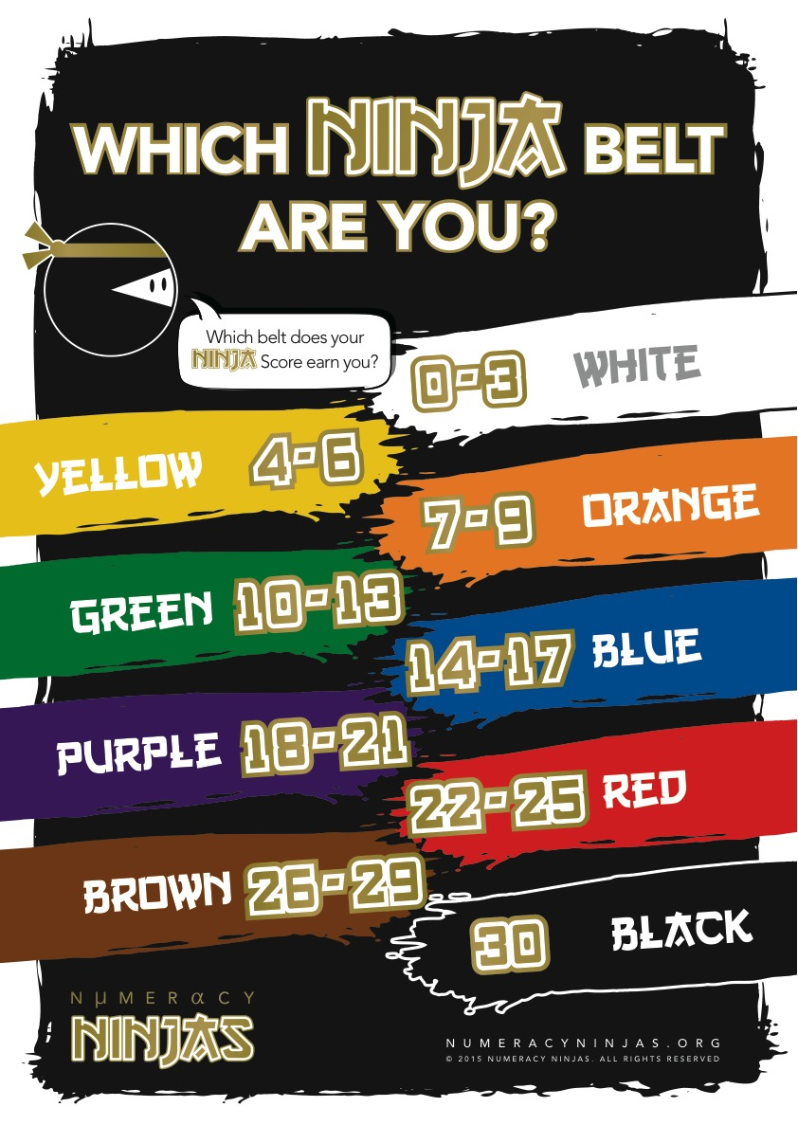
Week 8 Session 1
Calculate your Ninja Score to see which Ninja Belt you’ve earned today!

Slide 5
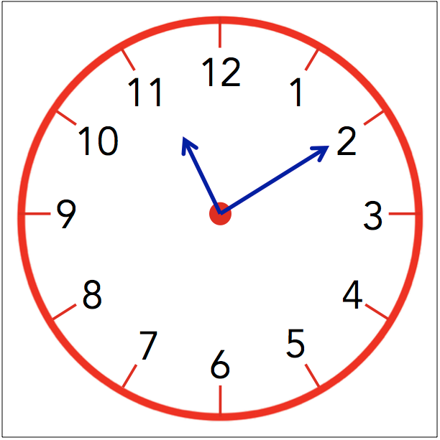
Week 9 Session 1
Mental Strategies Answers
Q | Question | Answer
1 | ☐ + 12 = 20 | 8
2 | What is double 94? | 188
3 | 168 + 10 | 178
4 | 45 − 20 | 25
5 | 9 = 3 + ☐ | 6
6 | 14 − 6 = 14 − 4 − ☐ | 2
7 | 39 = 39 × ☐ | 1
8 | Draw hands on the clock face showing 11:10 pm | See clock above
9 | 63 − 10 | 53
10 | 197 + 40 | 237

Slide 6
Week 9 Session 1
Timestables Answers
Q | Question | Answer
1 | 7 × 3 = ☐ | 21
2 | 80 ÷ 10 = ☐ | 8
3 | 3 × ☐ = 9 | 3
4 | 16 ÷ ☐ = 8 | 2
5 | 10 × 2 = ☐ | 20
6 | 16 ÷ 8 = ☐ | 2
7 | ☐ × 9 = 9 | 1
8 | ☐ ÷ 7 = 7 | 49
9 | 4 × 8 = ☐ | 32
10 | 20 ÷ 4 = ☐ | 5

Slide 7
Week 9 Session 1
Key Skills Answers
Q | Question | Answer
1 | What is the value of 4³? | 64
2 | 1/5 = 9/☐ | 45
3 | 3903 + 6770 | 10673
4 | (8 + 3) × 5 | 55
5 | Write 881034 in words. (Use the opposite page for your answer) | Eight Hundred and Eighty One Thousand and Thirty Four
6 | 0.98 ÷ 100 | 0.0098
7 | (−5) × (−8) | 40
8 | Round 6.5893 to 2 d.p. | 6.59
9 | 5 + (−8) | −3
10 | Round 423 to 2 s.f. | 420

Slide 8
Week 9 Session 1
Calculate your Ninja Score to see which Ninja Belt you’ve earned today!

