Slide 1
Properties of Shapes
Step 1: Measuring Angles in Degrees
© Classroom Secrets Limited 2018

Slide 2
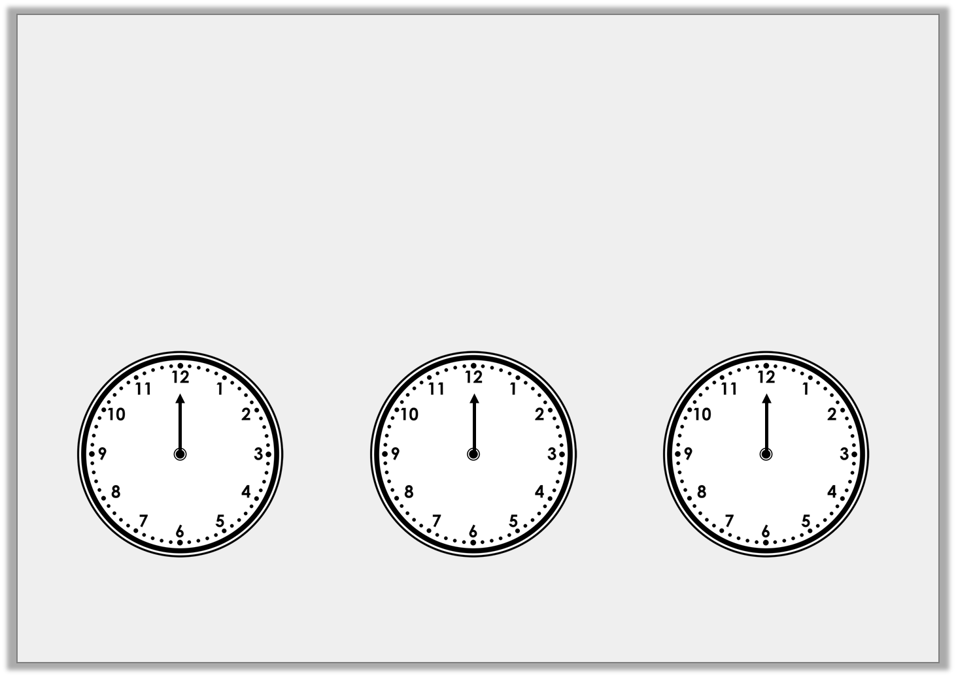
Introduction
The hour hand is stuck on 12.
Draw the minute hand on the clock so the time shown makes an acute angle:
Draw the minute hand on the clock so the time shown makes a right angle:
Draw the minute hand on the clock so the time shown makes an obtuse angle:
© Classroom Secrets Limited 2018

Slide 3
Introduction
The hour hand is stuck on 12.
Draw the minute hand on the clock so the time shown makes an acute angle:
Draw the minute hand on the clock so the time shown makes a right angle:
Draw the minute hand on the clock so the time shown makes an obtuse angle:
Any time between 12:16 – 12:29 and 12:31 – 12:44
Any time between 12:46 and 12:14
Either 12:15 or 12:45
© Classroom Secrets Limited 2018

Slide 4
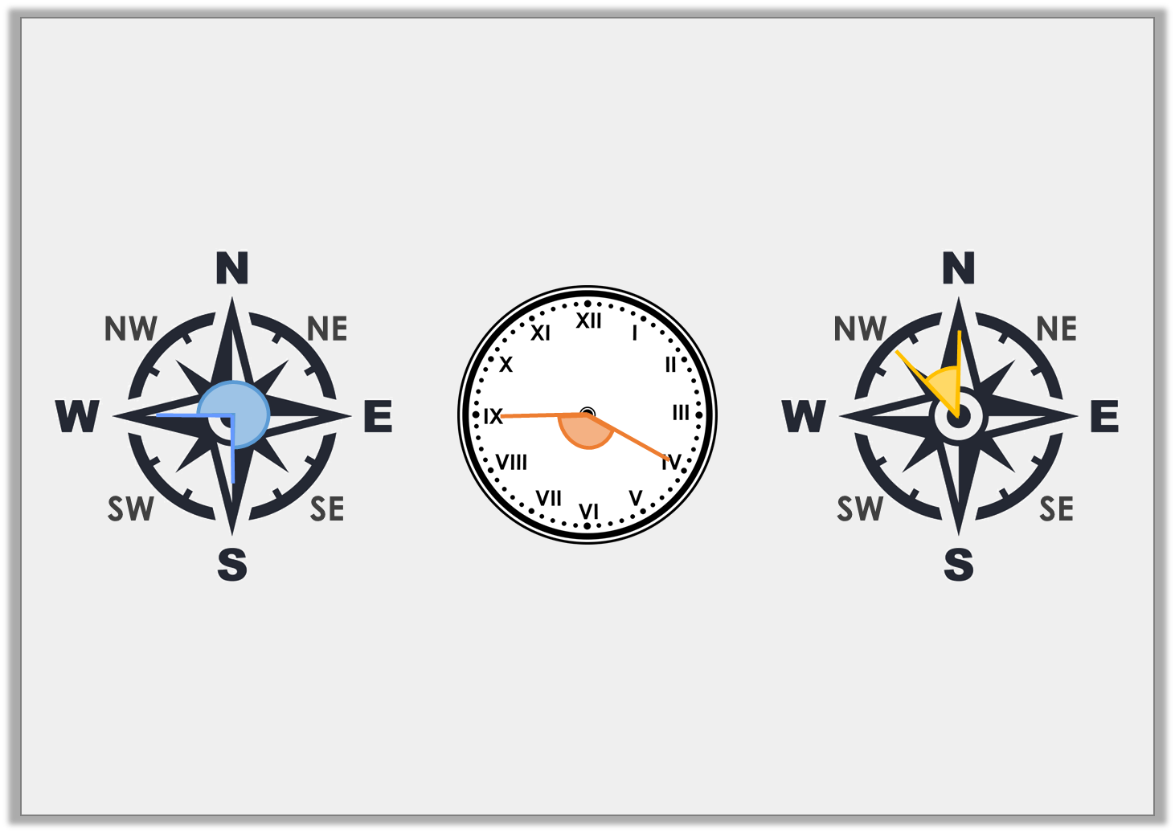
Varied Fluency 1
Label each image with the name of the angle.
A.
B.
C.
© Classroom Secrets Limited 2018

Slide 5
Varied Fluency 1
Label each image with the name of the angle.
A.
B.
C.
Reflex angle
Obtuse angle
Acute angle
© Classroom Secrets Limited 2018

Slide 6
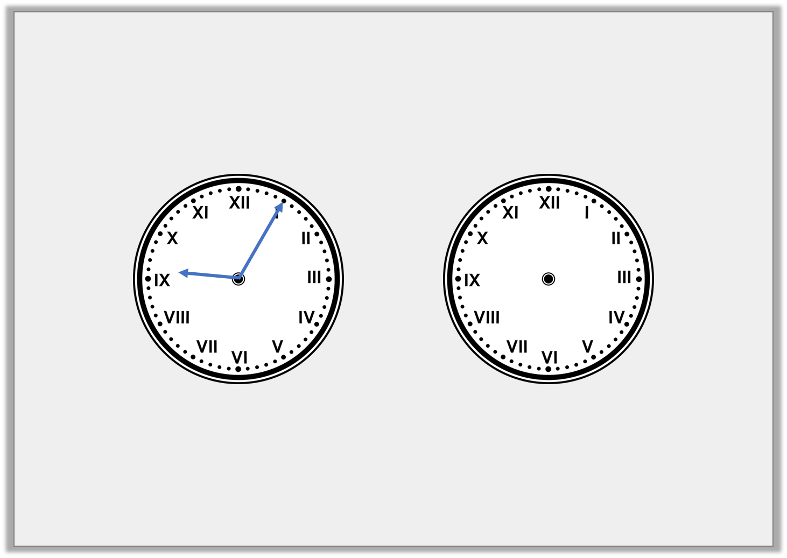
Varied Fluency 2
Look at the time on the clock. Draw where the minute hand will be after a 180° turn clockwise.
© Classroom Secrets Limited 2018

Slide 7
Varied Fluency 2
Look at the time on the clock. Draw where the minute hand will be after a 180° turn clockwise.
© Classroom Secrets Limited 2018

Slide 8
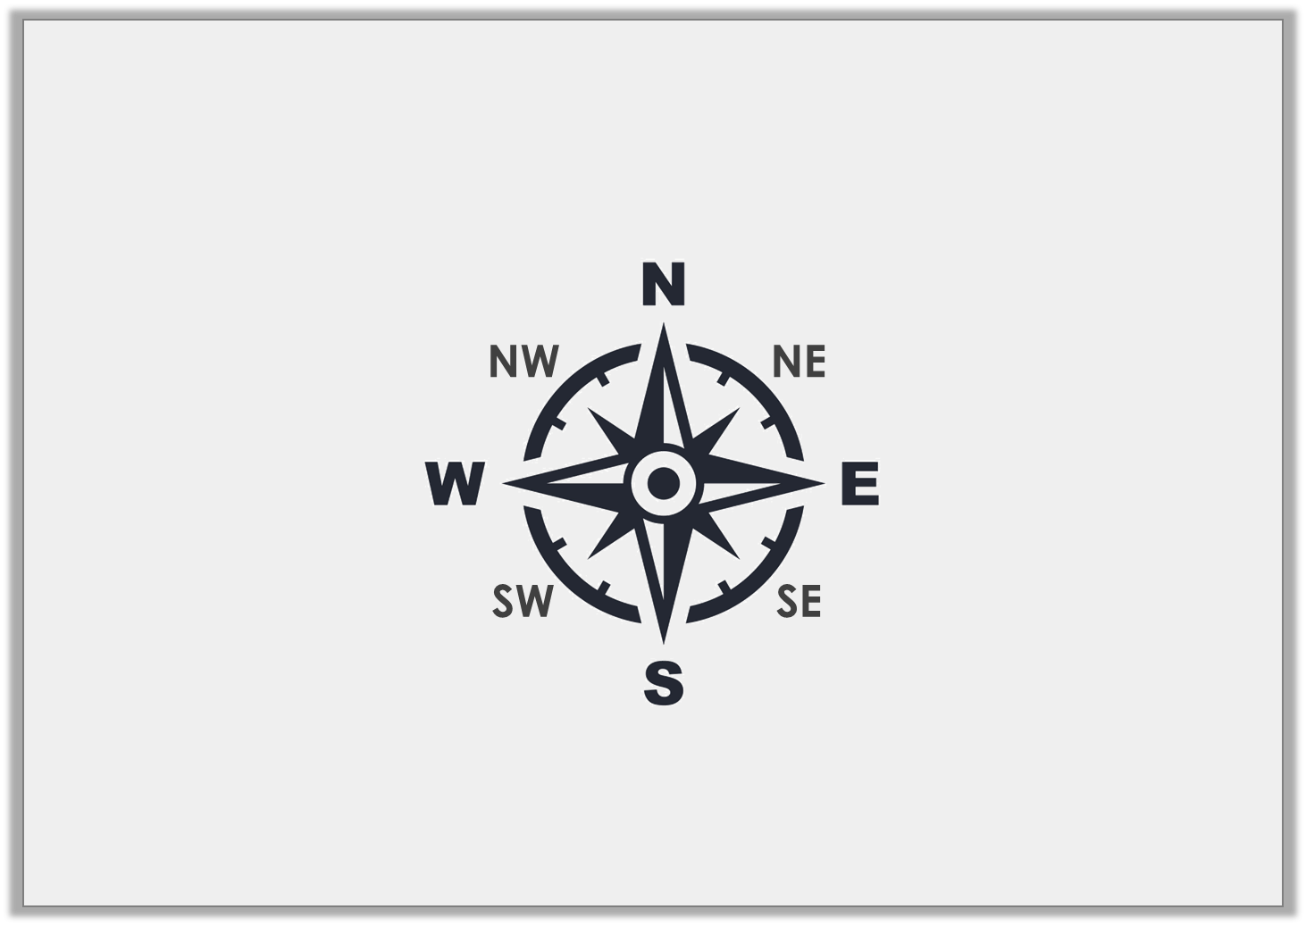
Varied Fluency 3
How many degrees will I move through if I turn from SE to N anti-clockwise?
© Classroom Secrets Limited 2018

Slide 9
Varied Fluency 3
How many degrees will I move through if I turn from SE to N anti-clockwise?
135°
© Classroom Secrets Limited 2018

Slide 10
Varied Fluency 4
How many turns are equal to 270°?
1
8
© Classroom Secrets Limited 2018

Slide 11
Varied Fluency 4
How many turns are equal to 270°?
6 turns
1
8
1
6
2
5
3
4
© Classroom Secrets Limited 2018

Slide 12
Varied Fluency 4
Use >, < or = to complete the equation.
3
4
360° |  | turn
© Classroom Secrets Limited 2018

Slide 13
Varied Fluency 4
Use >, < or = to complete the equation.
3
4
360° | > | turn
© Classroom Secrets Limited 2018

Slide 14
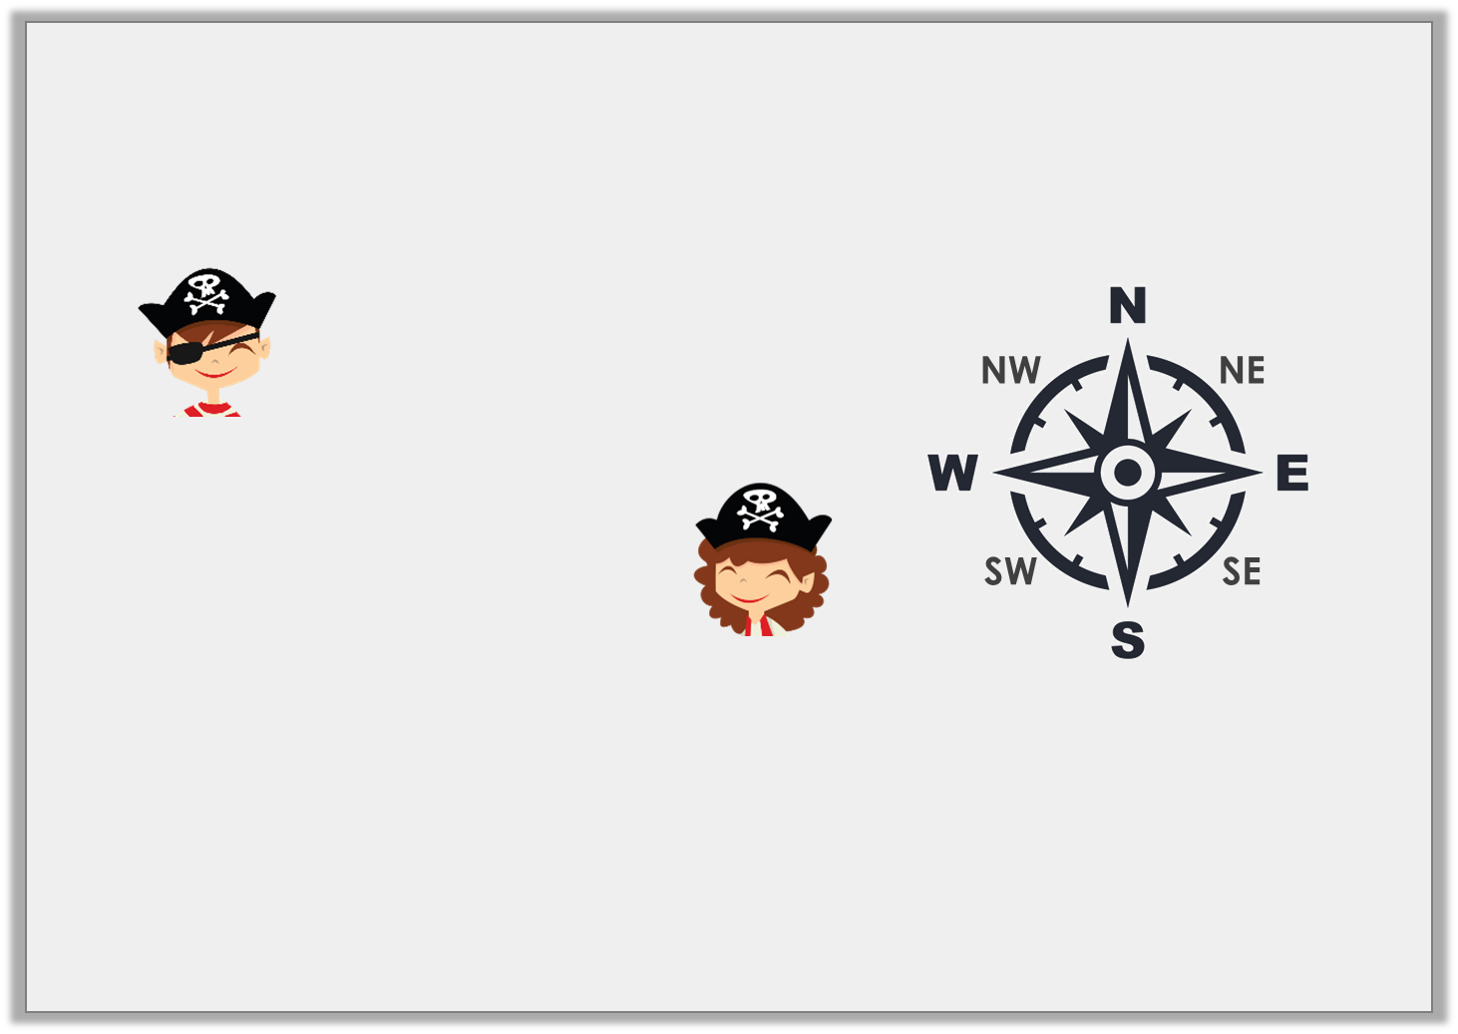
Reasoning 1
These pirates are facing south east and their captain has told them that they need to turn to face north east.
Who do you agree with? Explain.
We need to turn through
a reflex angle.
Henry
We need to make a turn anti-clockwise.
1
4
Olga
© Classroom Secrets Limited 2018

Slide 15
Reasoning 1
These pirates are facing south east and their captain has told them that they need to turn to face north east.
Who do you agree with? Explain.
They are both correct because…
We need to turn through
a reflex angle.
Henry
We need to make a turn anti-clockwise.
1
4
Olga
© Classroom Secrets Limited 2018

Slide 16
Reasoning 1
These pirates are facing south east and their captain has told them that they need to turn to face north east.
Who do you agree with? Explain.
They are both correct because a reflex angle of 270° clockwise will reach NE and a (90°) turn anti-clockwise will also reach NE.
We need to turn through
a reflex angle.
Henry
We need to make a turn anti-clockwise.
1
4
Olga
1
4
© Classroom Secrets Limited 2018

Slide 17
Problem Solving 1
Which of the following cards could be
used to complete the statement?
Give all of the possible answers.
N
NE
E
SE
S
SW
W
NW
A 270° turn | > | turning from NW to ______ anti-clockwise | > | a 90° turn
© Classroom Secrets Limited 2018

Slide 18
Problem Solving 1
Which of the following cards could be
used to complete the statement?
Give all of the possible answers.
S, SE and E.
N
NE
E
SE
S
SW
W
NW
A 270° turn | > | turning from NW to ______ anti-clockwise | > | a 90° turn
© Classroom Secrets Limited 2018

Slide 19
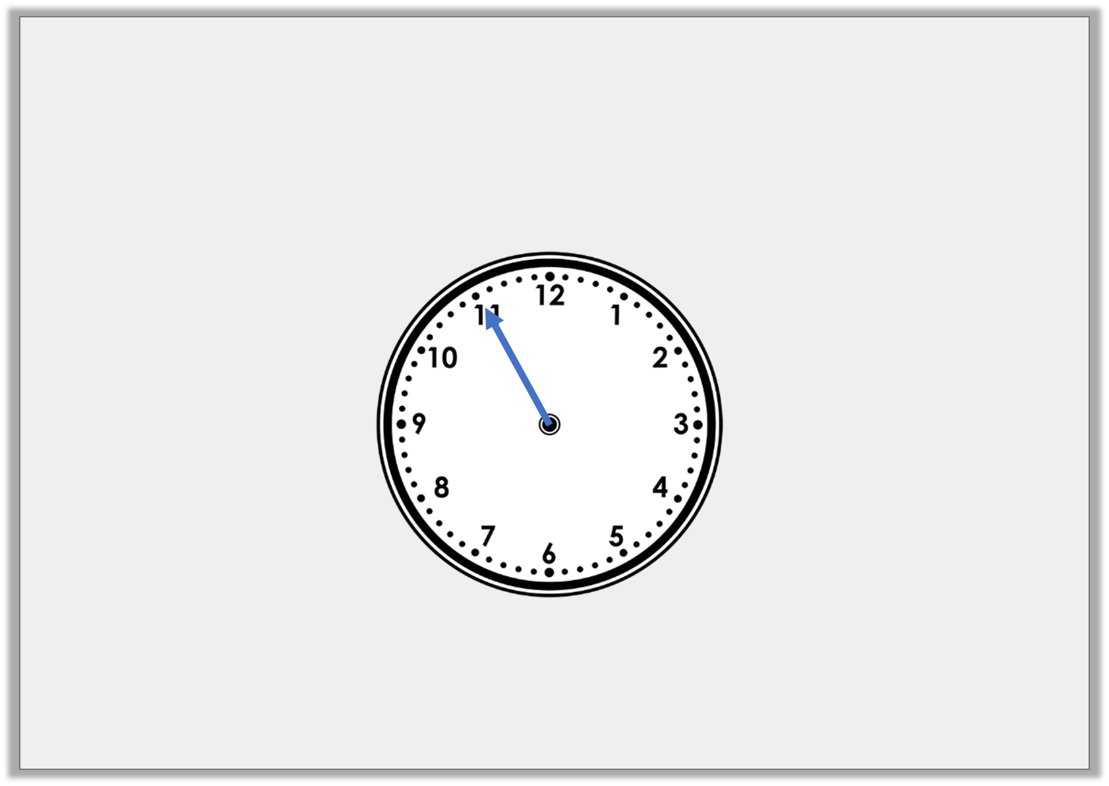
Problem Solving 2
Starting at 06:55, the minute hand makes more than 4 but
fewer than 7 quarter turns clockwise.
What times could the clock show after the turns?
© Classroom Secrets Limited 2018

Slide 20
Problem Solving 2
Starting at 06:55, the minute hand makes more than 4 but
fewer than 7 quarter turns clockwise.
What times could the clock show after the turns?
5 quarter turns clockwise – 08:10
6 quarter turns clockwise – 08:25
© Classroom Secrets Limited 2018

