Slide 1
Progression in Mastery
Year 6 Classify Living Things
Let’s challenge ourselves to classify living things!
©Deepening Understanding LTD 2020

Slide 2
Remember the Science
We can group plants into flowering plants and non-flowering plants.
Can you name any examples of flowering and non-flowering plants?
Flowering plants produce ______ which grow as separate plants by developing roots.
Non-flowering plants do not produce ______. Instead, they produce ______ on their leaves.
©Deepening Understanding LTD 2020
Notes:
Flowering plants produce seeds which grow as separate plants by developing roots.
Non-flowering plants do not produce seeds. Instead, they produce spores on their leaves.

Slide 3
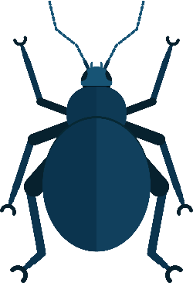
Remember the Science
Animals can be broadly classified into two groups.
Can you name any examples of vertebrates and invertebrates?
Vertebrates have a ________ inside their body.
Invertebrates do not have a ________. They have soft bodies or an outer ________.
©Deepening Understanding LTD 2020
Notes:
Vertebrates have a backbone inside their body.
Invertebrates do not have a backbone. They have soft bodies or an outer shell.

Slide 4
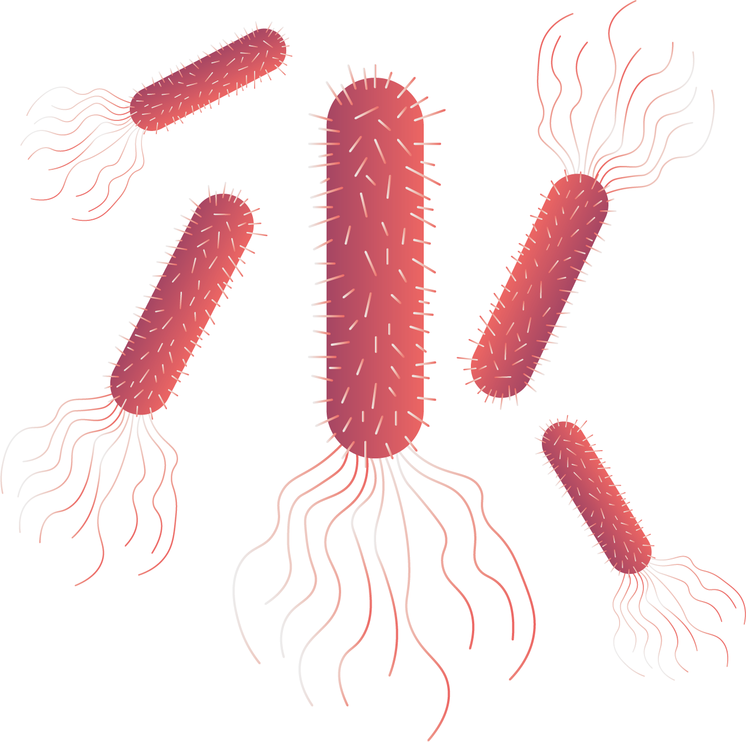
Remember the Science
Microorganisms are very small living things.
We can only see them using a ________.
Can you remember the name of any helpful bacteria?
Bacteria is a microorganism which breaks down plants into ________.
We sometimes refer to microorganisms as ‘________’. Harmful ________ can make us ill.
©Deepening Understanding LTD 2020
Notes:
We can only see them using a microscope.
Bacteria is a microorganism which breaks down plants into nutrients.
We sometimes refer to microorganisms as ‘germs’. Harmful germs can make us ill.

Slide 5
Remember the Science
All living things carry out seven life processes. We can
remember these using the acronym ‘MRS GREN’.
Movement
Respiration
Sensitivity
Growth
Reproduction
Excretion
Nutrition
©Deepening Understanding LTD 2020
Notes:
Go over MRS GREN (7 life processes) - Movement, Respiration, Sensitivity, Growth, Reproduction, Excretion and Nutrition.

Slide 6
Talk like a Scientist
Do you agree with Anita?
Explain your reasoning.
All vertebrates share the same characteristics.
©Deepening Understanding LTD 2020

Slide 7
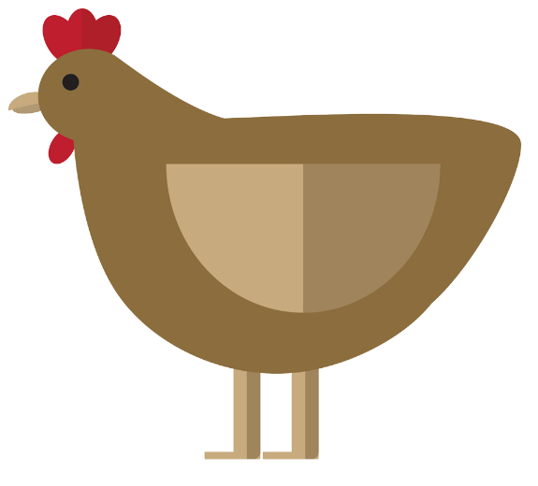
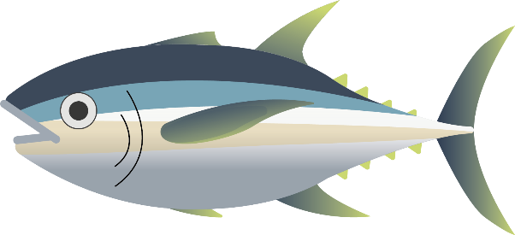
Remember the Science
Vertebrates can be classified into smaller groups...
Can you name the different groups using the images above?
mammals
amphibians
reptiles
fish
birds
©Deepening Understanding LTD 2020

Slide 8
Know the Science
Although snakes, monkeys and chickens are all vertebrates, their characteristics vary greatly as they belong to different groups.
For example, although they all live on land, reptiles lay eggs,
whereas mammals give birth to live offspring.
What characteristics do birds share with reptiles or mammals?
©Deepening Understanding LTD 2020

Slide 9
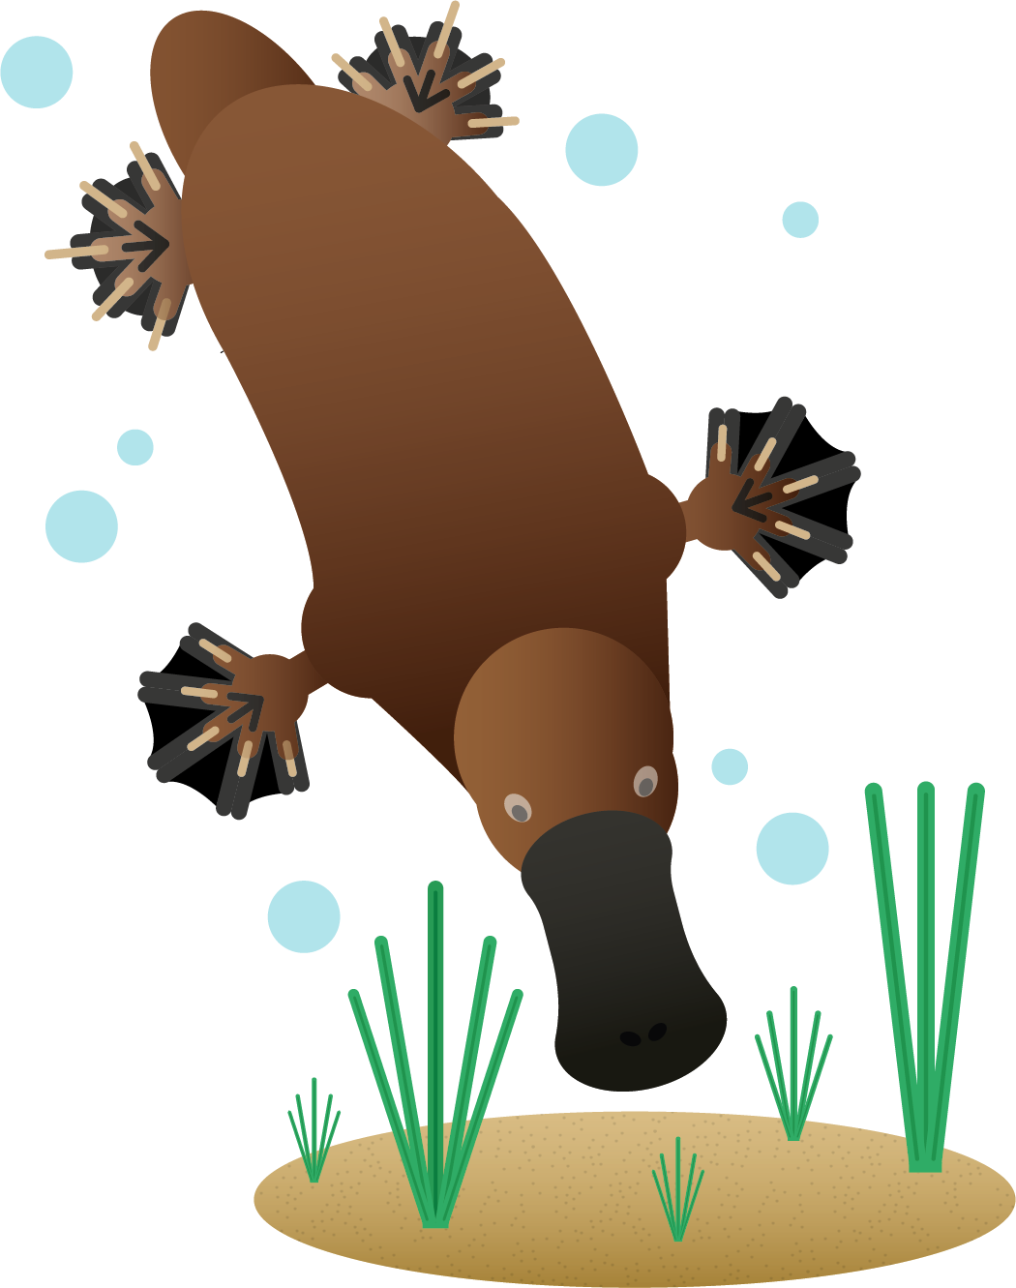
Know the Science
We can classify animals based on their characteristics, however it is important to note that there are anomalies that exist.
Did you know..?
The platypus is one of only five mammal species in the world that lay eggs instead of giving birth to live young!
©Deepening Understanding LTD 2020

Slide 10
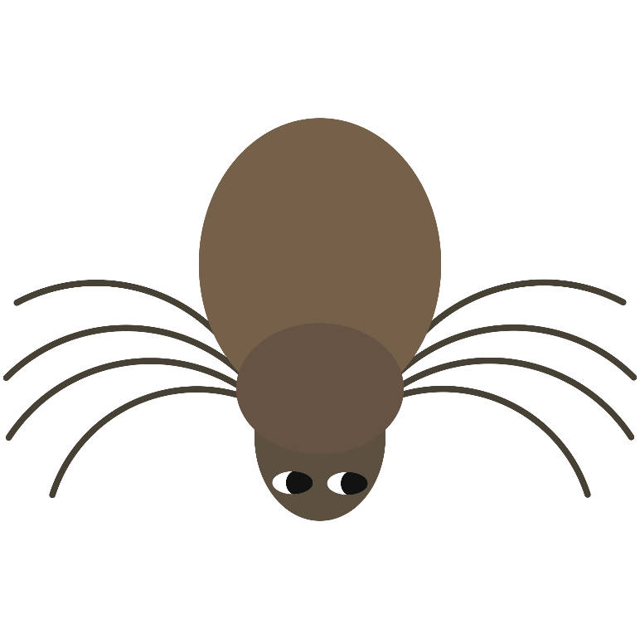
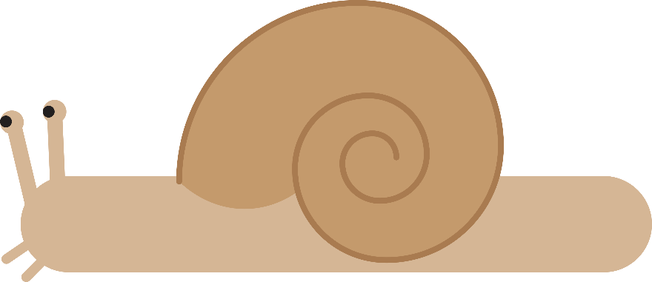
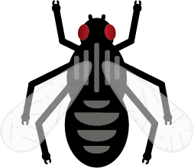
Know the Science
Invertebrates can be classified into smaller groups too.
For example…
Can you name any of these different groups using the images?
insects
molluscs
arachnids
worms
©Deepening Understanding LTD 2020

Slide 11
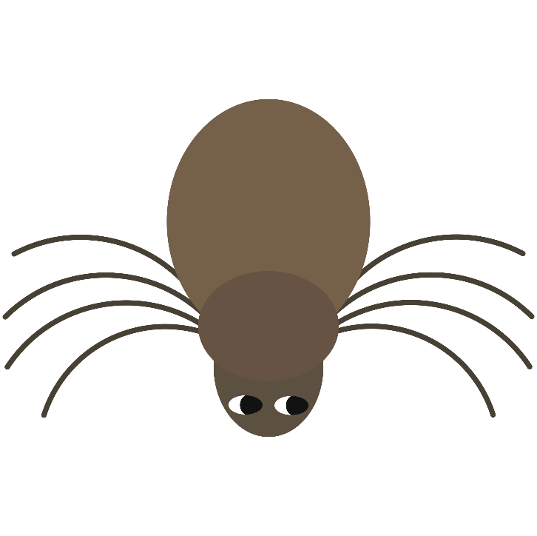
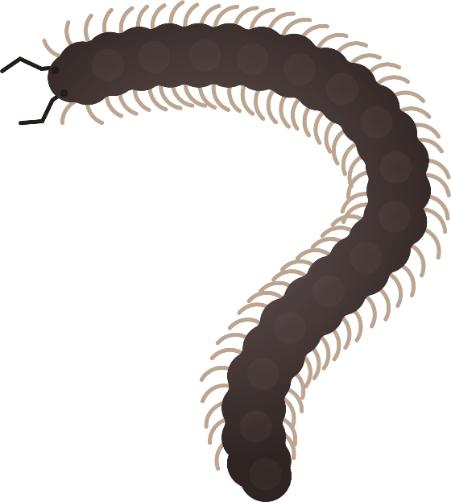
Know the Science
Some invertebrates have no skeleton at all, such as…
Others have an exoskeleton, which is a skeleton outside
of their body, rather than inside like vertebrates have.
©Deepening Understanding LTD 2020

Slide 12
Talk like a Scientist
Do you agree with Anita?
Explain your reasoning.
Bats can be classified as birds because they can fly.
©Deepening Understanding LTD 2020

Slide 13
Independent Task
Become a Scientist
©Deepening Understanding LTD 2020

Slide 14
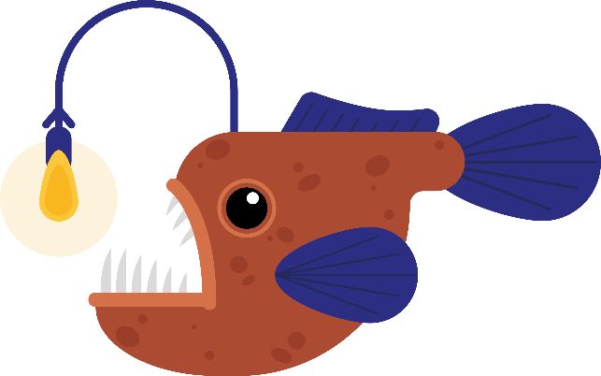
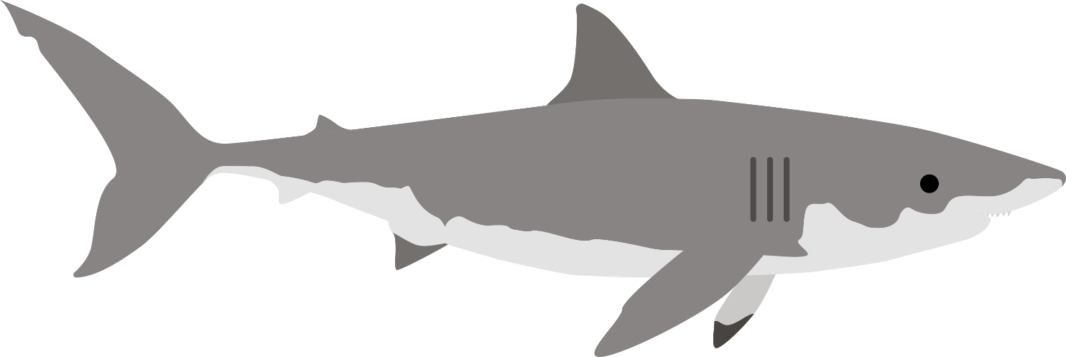
Exit task – Checking the tricky bits
Anita thinks that these animals are from the same class of animals.
Do you agree with her? Explain your reasoning.
©Deepening Understanding LTD 2020

