Slide 2
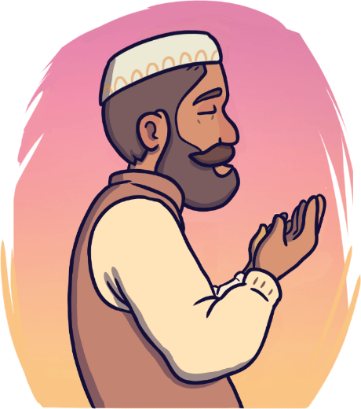
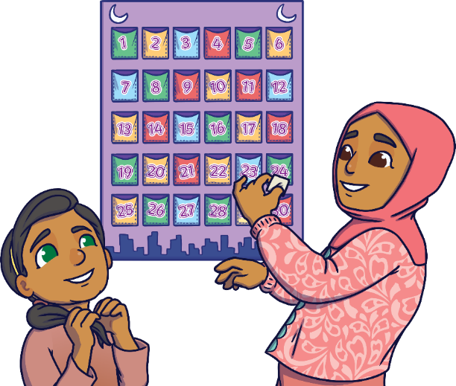
Rameena’s Ramadan
Read the book ‘Rameena’s Ramadan’ and look at the illustrations.
To see a question about the book, click this button:
?

Slide 3
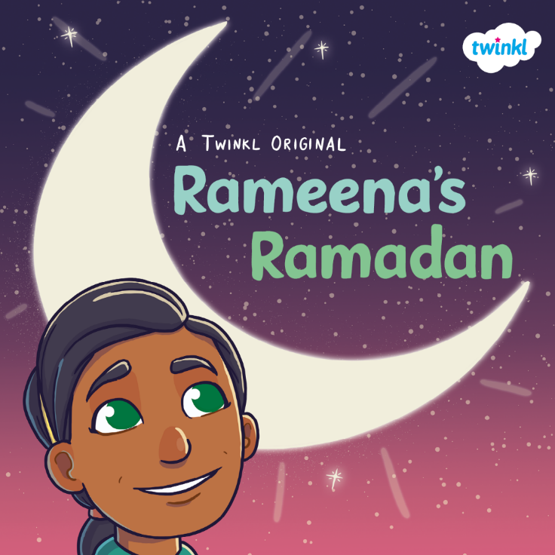
?
What do you think this book is going to be about?
?
Do you think it is fiction or non-fiction?
?
Who do you think is on the front cover?

Slide 4
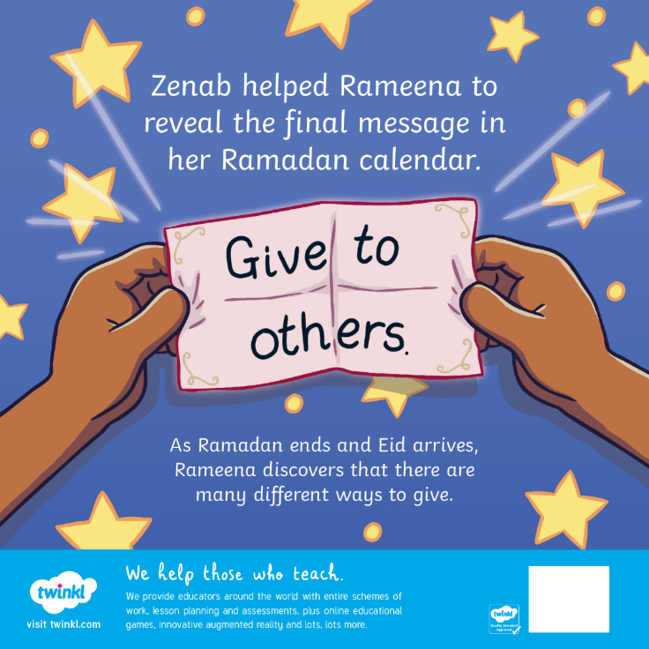
?
Have you heard of Ramadan before? What is it?
?
What kind of things can you give to others?

Slide 5
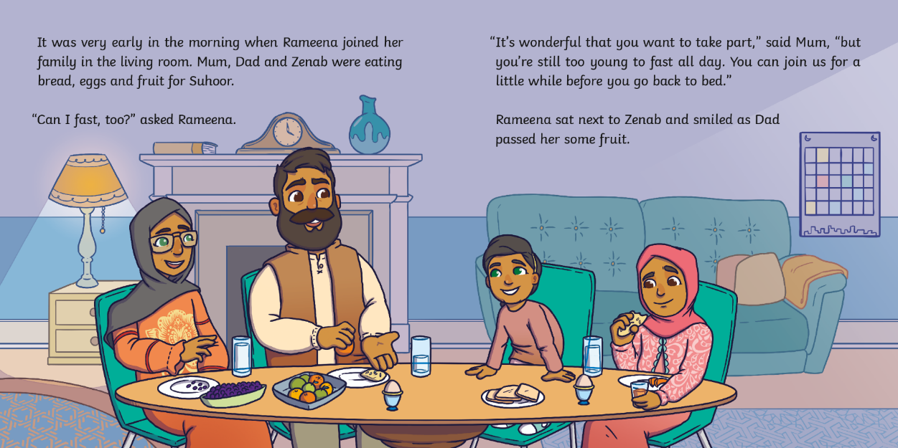
?
Why can’t Rameena fast with her parents?

Slide 6
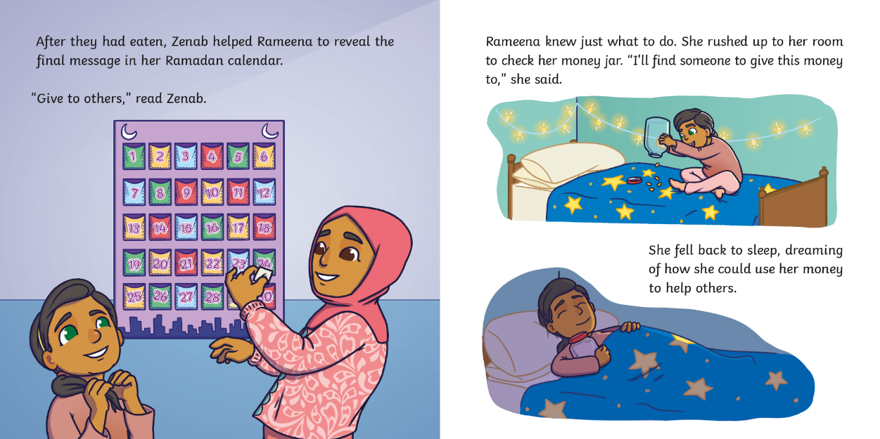
?
What does Rameena decide to do with her money?

Slide 7
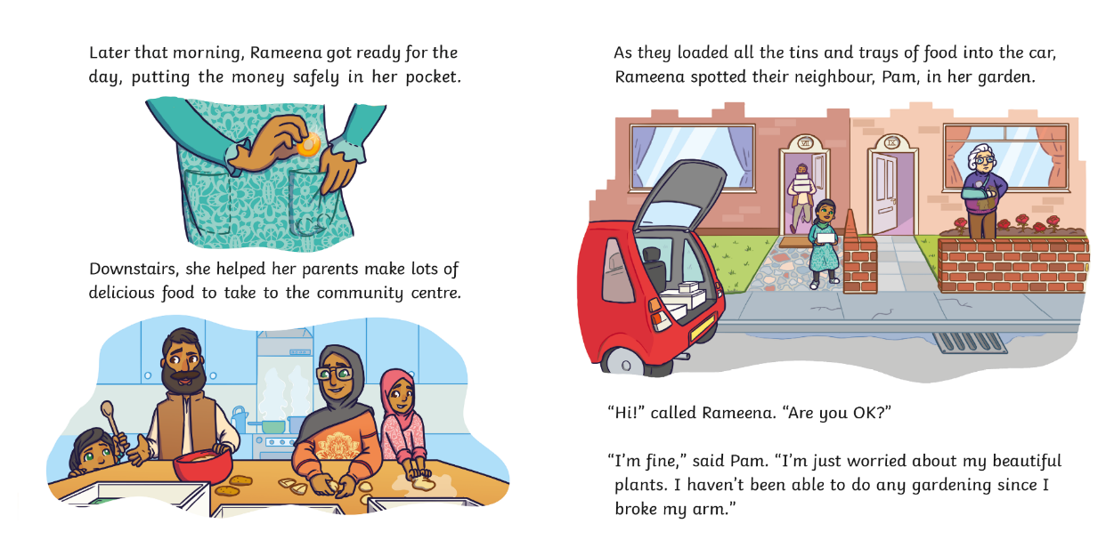
?
Why is Pam worried?

Slide 8
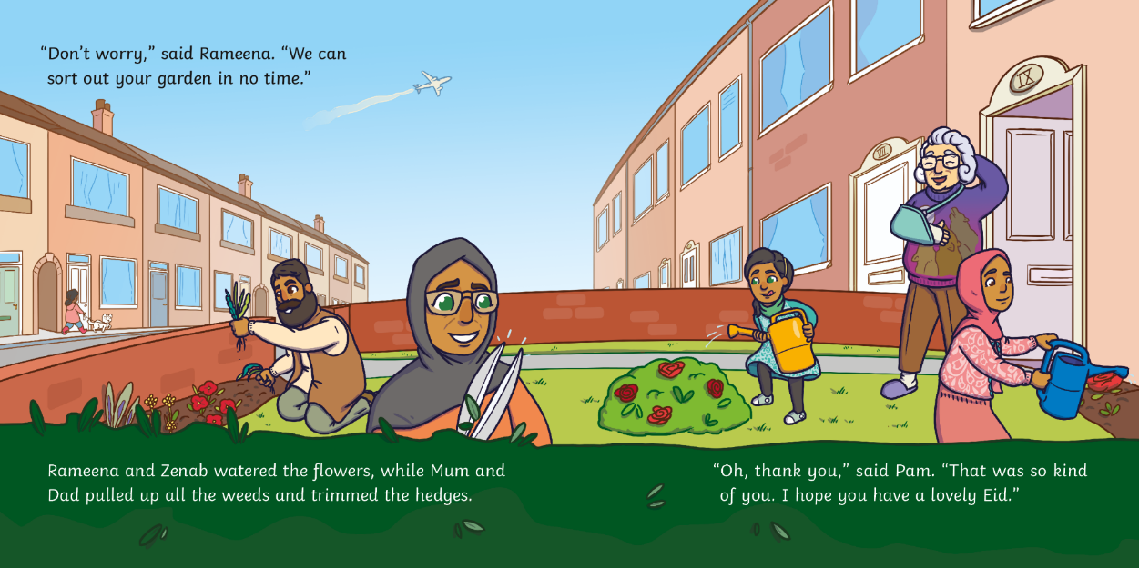
?
What did Rameena and her family do that was ‘kind’?

Slide 9
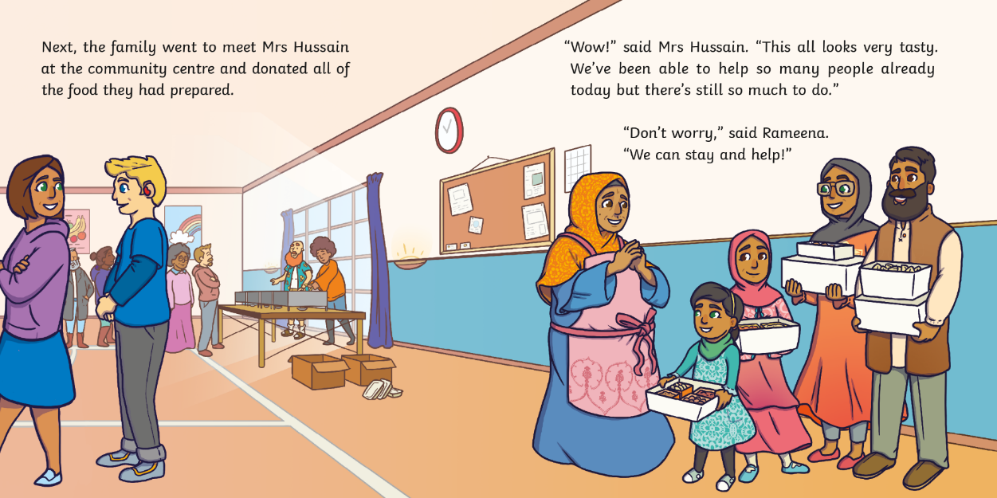
?
What do you think the food is for?

Slide 10
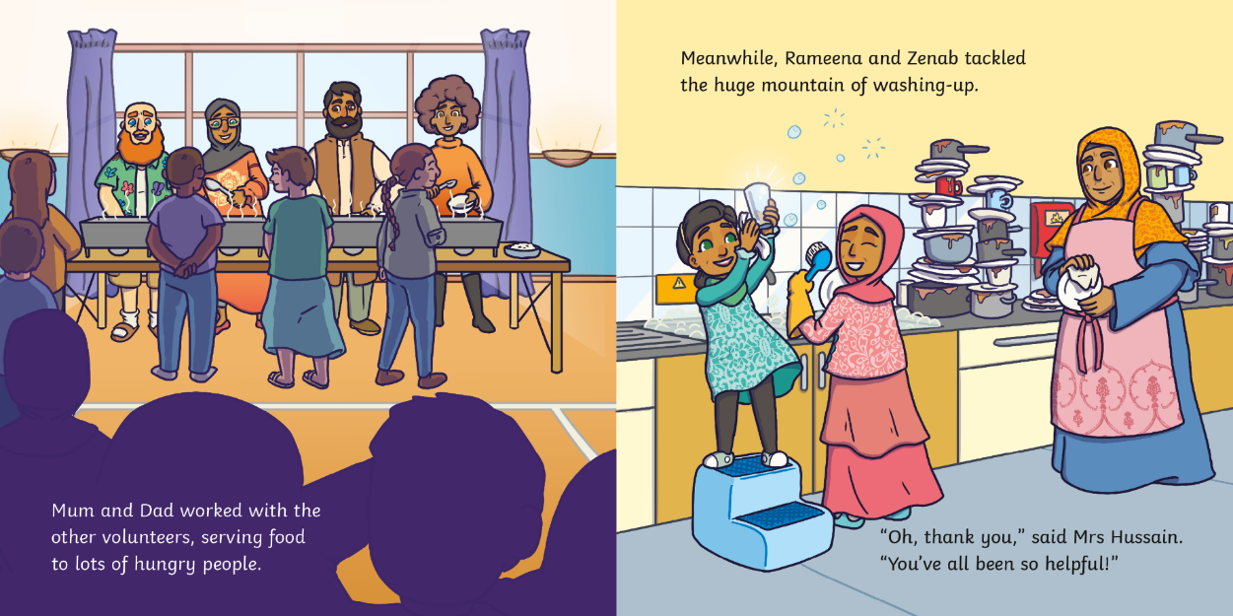
?
How do you think Mrs Hussain feels?

Slide 11
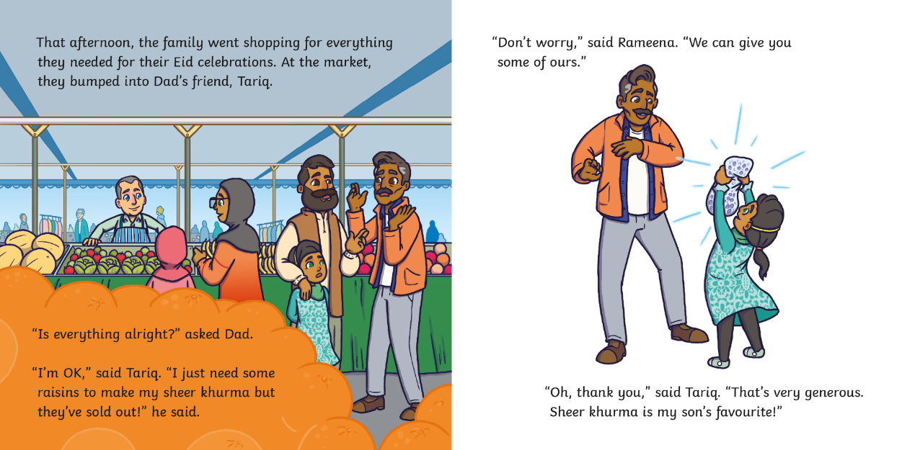
?
What does ‘generous’ mean?

Slide 12
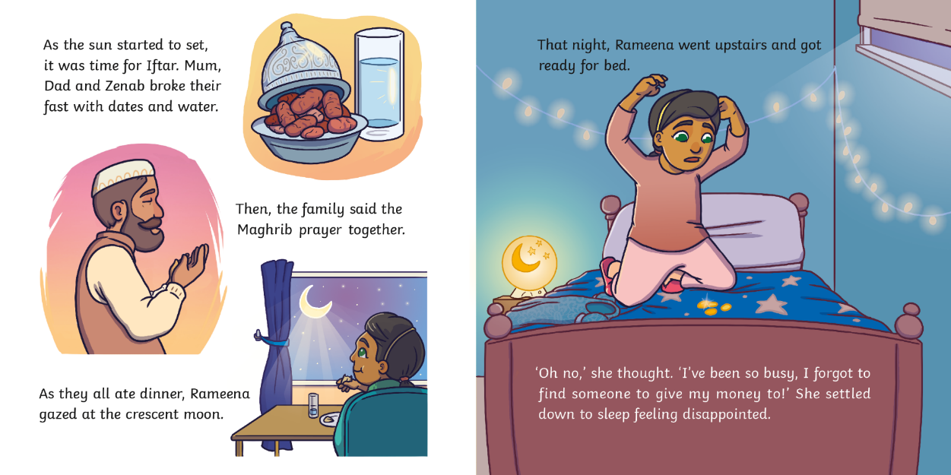
?
Why is Rameena disappointed?

Slide 13
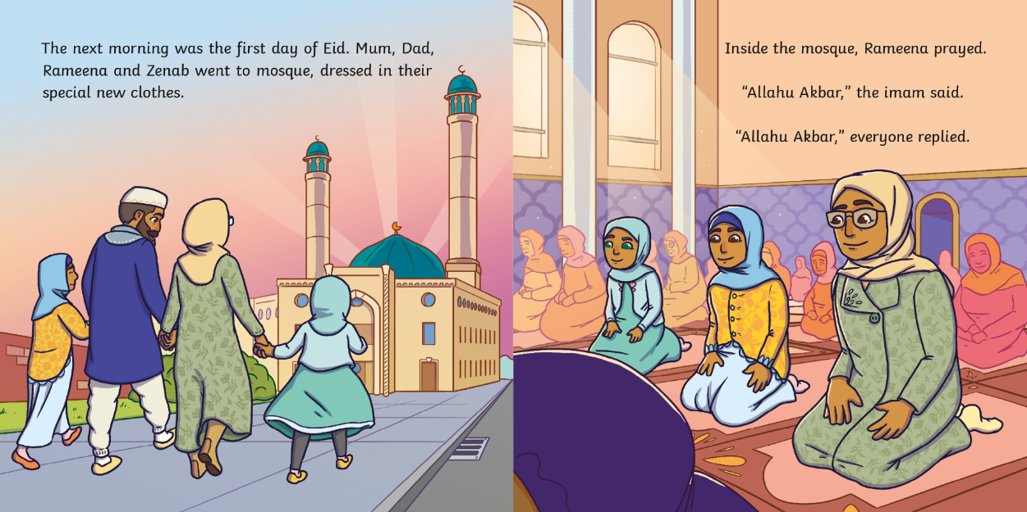
?
What did Rameena do at the mosque?

Slide 14
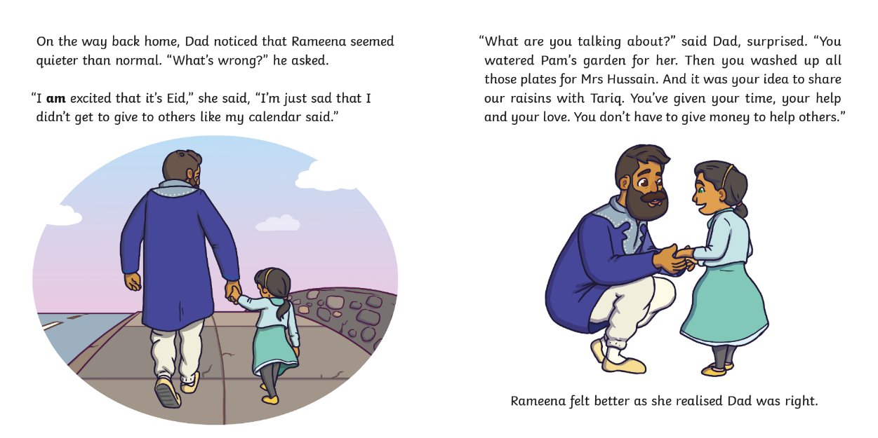
?
Dad says, “You don’t have to give money to help others.” What does he mean?

Slide 15
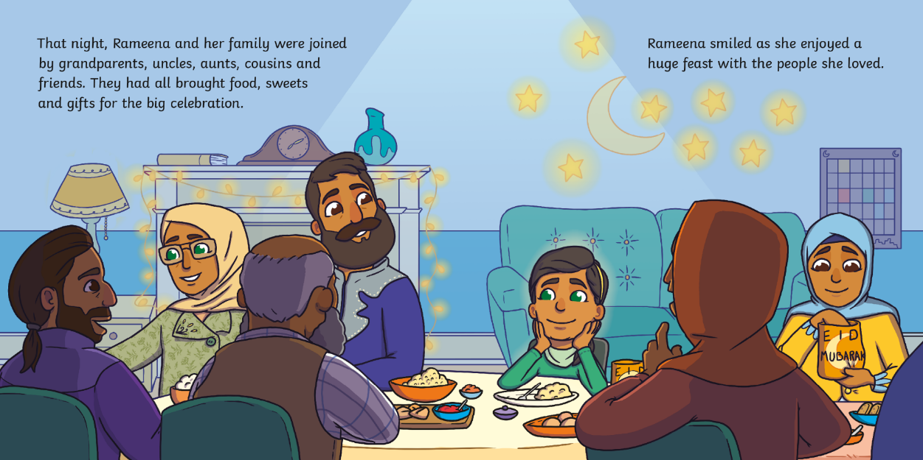
?
Is Rameena feeling happier? How do you know?

Slide 16
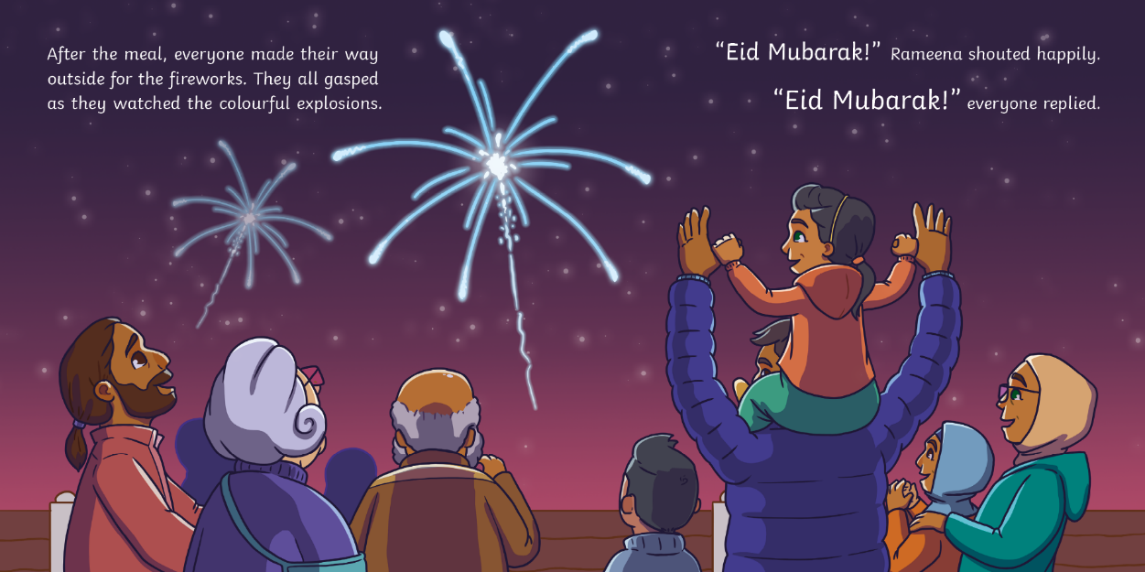
?
Why did everyone gasp?

Slide 17
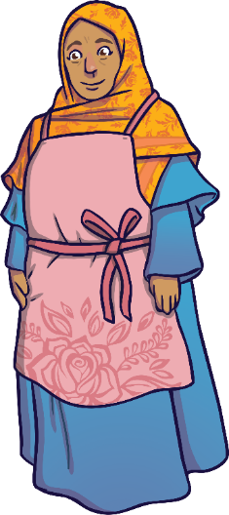
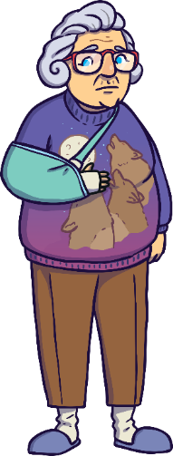
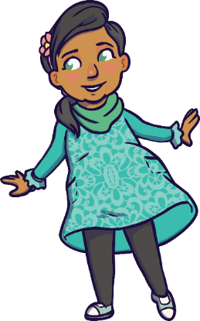
?
Who is the main character in this story?
Mrs Hussain
Rameena
Pam

Slide 18
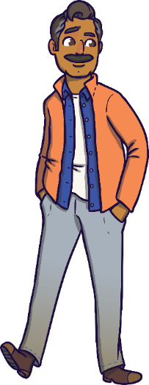
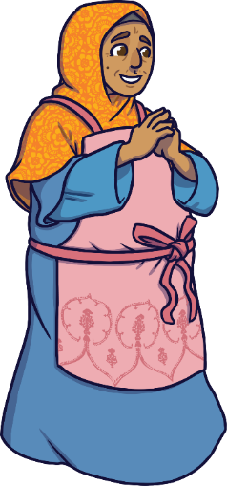
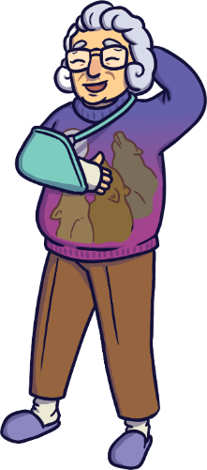
?
Who does Rameena help first?
Tariq
Mrs Hussain
Pam

Slide 19
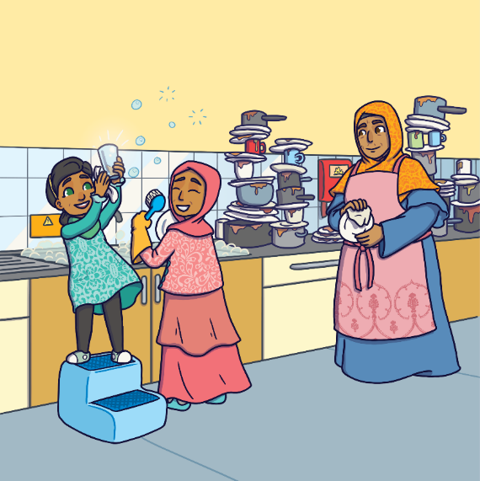
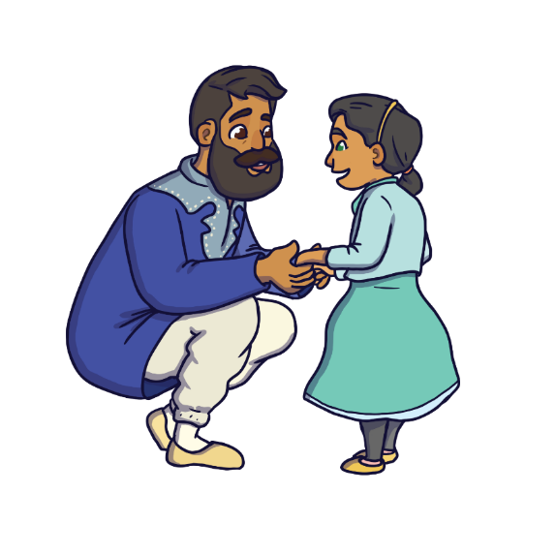
?
Do you think there is a message in this story? What do you think it might be?

Slide 20
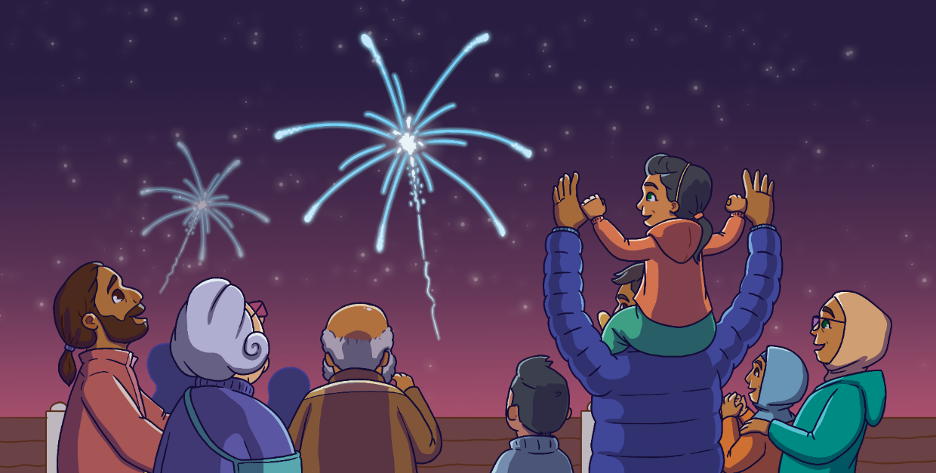
?
?
Have you been to a different celebration that had fireworks?
Have you been to an Eid celebration before?

Slide 21
?
How would you describe this book in one sentence?

